Slide 1
ONGOING TEACHER LEARNING: A STUDY OF TEACHERS
OVER THEIR INITIAL 8 YEARS
Clive Beck, Clare Kosnik, Tiffany Harris, Belinda Longe, Monica McGlynn-Stewart,
Julie Middleton, and Elizabeth Rosales
OISE/University of Toronto

Slide 2
OUR LONGITUDINAL STUDY OF TEACHERS
42 teachers – mainly elementary and middle school
20 began teaching in 2004 and 22 in 2007
Interviewed and observed every year since then
Largely qualitative study

Slide 3
STUDY QUESTIONS
1. How do teachers’ views and practices change over time?
2. What are the main factors?
3. How can PD and ITE support continued teacher growth?

Slide 4
Teachers Preferred Informal Professional Learning Activities
Cohort 1 Teachers’ Average Ratings for PD Activities (scale 1-5) N = 18 Average
Trying things out in your own classroom - 4.7
Observing/planning with teachers in your school, at or near grade level - 4.6
Observing/talking to teachers beyond your school - 3.8

Slide 5
Informal Professional Learning Continued
Formal mentoring by a teacher, coach or administrator - 3.4
PD at a school-wide level - 3.4
Short PD events beyond school - 2.9
Your own professional reading - 4.4
Your own subject content reading - 4.3

Slide 6
The Teachers Learned Most By Informal Means
“[We should recognize] the largely private, unaided learning from experience through which most teachers learn to survive, become competent, and develop.” (Day, 1999, p. 2)
They learned, for example:
classroom management
prioritization of goals and topics
flexible planning
integration and individualization
how to make teaching engaging and relevant
use of technology
effective and feasible assessment
better work-life balance

Slide 7
Sources of Informal Learning
a. Classroom-based experimentation and observation
“Every year, just from classroom experience, I learn different ways to make lessons and activities interesting.”
b. Self-initiated professional reading
“I get an e-letter every day from ASCD...and it has tons of articles. They also give book reviews, or you can preview the first chapter of a book.”

Slide 8
Sources of Informal Learning Continued
C Learning from colleagues
d. Observing other teachers
“It’s so isolating to be the only 6th grade teacher, so it’s great to see another classroom in action.”
e. Voluntary teacher collaboration
f. Informal teacher leadership

Slide 9
Formal PD Activities
Induction and early mentoring
Coaching and later-career mentoring
Professional learning communities (PLCs)
Workshops and other short PD events
Professional courses

Slide 10
Concerns About Formal PD
a. Not enough teacher voice and choice
“If we gave teachers opportunities to learn about areas of professional development they feel are needed, whether as a whole school, a grade team, or an individual, I think it would be much better.”
b. Too much focus on system initiatives and test preparation
“I found [the coaching] very prescriptive and formulaic, just a matter of getting students ready for the standardized test, teaching them how to answer a question.”

Slide 11
Learning During Their First Eight Years
they are intelligent, caring, educated
they have a lot of incentive to get it right
they have a large “sample” to observe and “experiment” with

Slide 12
Most Teacher Learning Happens Informally
abundant opportunities for informal learning
very limited opportunities for formal PD
often poor topic selection and pedagogy in PD

Slide 13
Formal PD Needs To Build on Teachers’ Knowledge and Be Less Top-Down
“[When] teacher learning is…imposed from above by the government or by principals, it often doesn’t work. It’s like with kids, when you’re always telling them exactly what to do and how to do it, the motivation isn’t there.”

Slide 14
ITE Can Support Ongoing Teacher Learning
“[ITE should be seen as] laying a foundation...and preparing novices to learn in and from their practice." (Feiman-Nemser, 2001, p. 1016).
In ITE we need to study:
Challenges of teaching
How much still needs to be learned
Methods of ongoing learning, especially informal
A vision of teaching: realistic, integrated, flexible

Slide 15
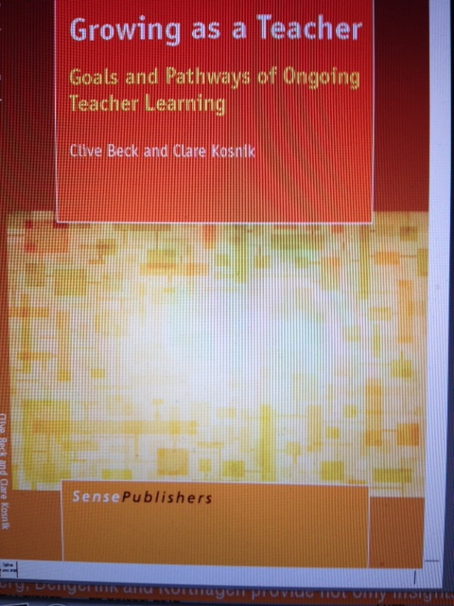

Slide 16
Sense Publishers.
Growing as a teacher: Goals and pathways of ongoing teacher learning
Clive Beck & Clare Kosnik

Slide 17
Stay connected:
www.literacyteaching.net

