Slide 1
Priorities in teacher education: the 7 key elements of preservice preparation
Clive Beck

Slide 2


Celebrating Teachers!

Slide 3
OUR LONGITUDINAL STUDY OF TEACHERS
42 teachers – mainly elementary and middle school
20 began teaching in 2004 and 22 in 2007

Slide 4
1. Teachers Learn a Great Deal by Informal Means
experimentation in the classroom
observing their students
feedback from students
observing other teachers
discussion with teachers
self-chosen reading (including online)

Slide 5
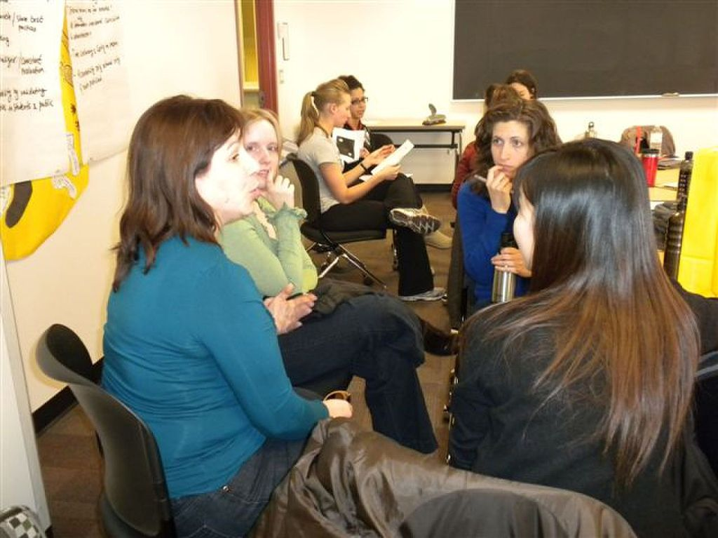
2. Teachers Learn Much More Informally Than Formally
Christopher Day (1999): “the largely private, unaided learning from experience through which most teachers learn to survive, become competent, and develop” (p.2).

Slide 6
3. Areas of Informal Teacher Learning
a. Effective teaching strategies
“Every year, just from classroom experience, I learn different ways to make lessons and activities interesting.” (Anita, year 5)

Slide 7
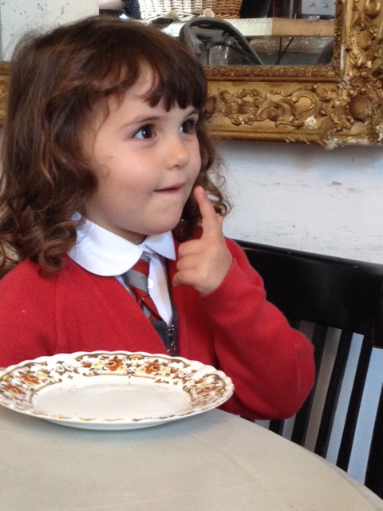
Areas of Informal Teacher Learning
b. Program planning.
c. Program integration.
d. Individualization of learning.
e. Effective and feasible assessment.

Slide 8
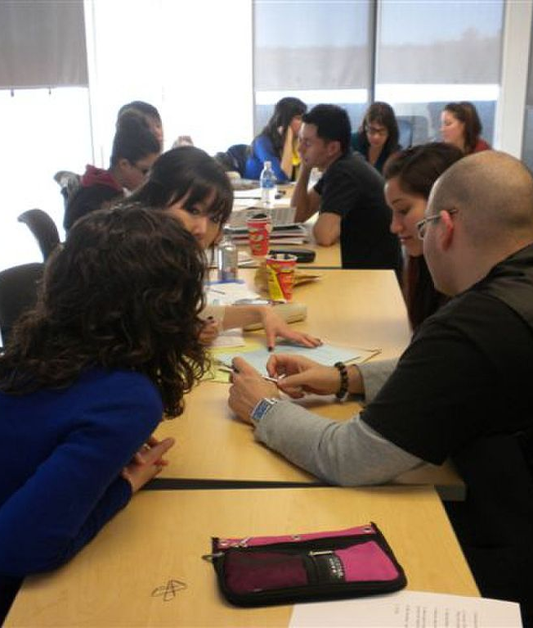
Areas of Informal Teacher Learning
f. Use of technology.
g. Building classroom community and teacher-student rapport.
h. How to make teaching feasible.

Slide 9
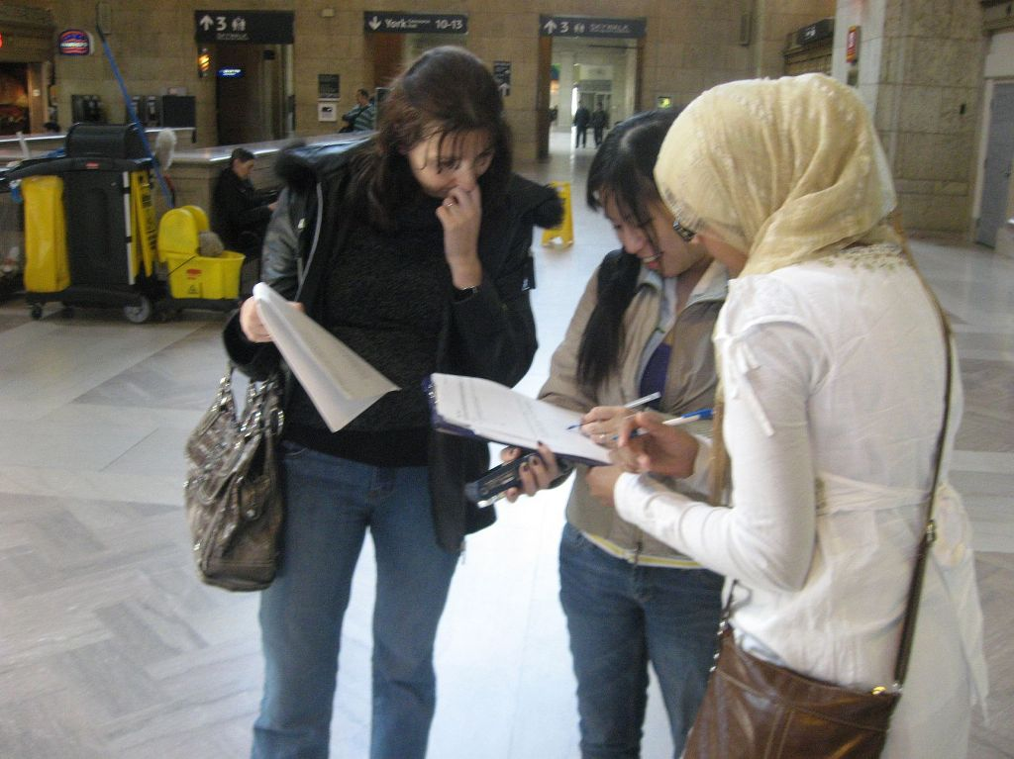
4. Teachers Adopt a Strong Decision-Making Role
To make the program feasible
To emphasize important topics
To increase student engagement

Slide 10
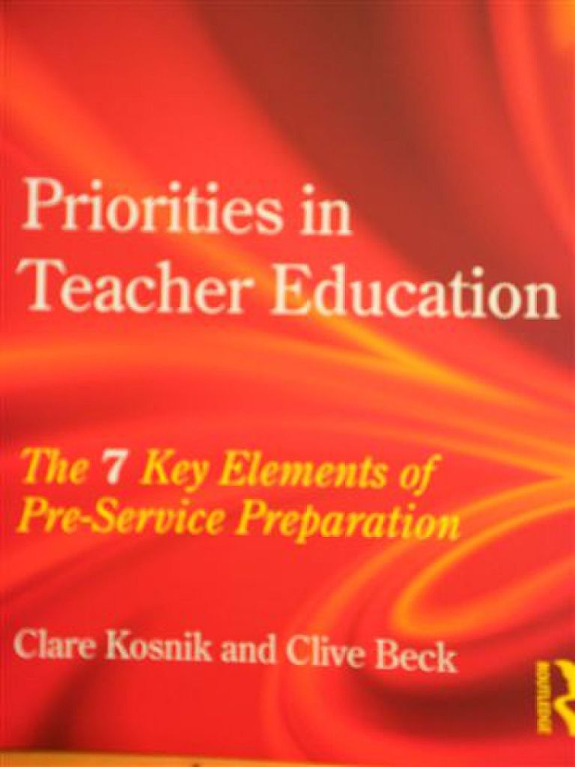
5. Teachers Establish Clearer Goals and Priorities
“I now understand which curriculum expectations are more important, rather than getting hung up on every little one…. I'm better at pulling out the big ideas and having students focus on those.” (Jeannie, year 6)

Slide 11
2012 Teachers’ Main Goals for Their Students - Frequency
Social development - 18
Love of learning - 11
Development of the self - 11
Sense of community - 10
Problem solving and critical thinking – 6

Slide 12
6. The Teachers Neglected Their Own Subject Learning
Deborah Ball: “Knowing content is…crucial to being inventive in creating worthwhile opportunities for learning” (2000, p. 242).
Hagger and McIntyre: “Unless teachers feel secure about what they are teaching, they tend to teach in a defensive way…communicating what they know and avoiding…thoughtful questions from pupils” (2006, p. 5).

Slide 13
IMPLICATIONS FOR PRESERVICE TEACHER EDUCATION:
7 PRIORITIES

Slide 14

Priority 1. Program Planning
Relevance
Prioritization
Integration around big ideas
Individualization
Overarching goals

Slide 15
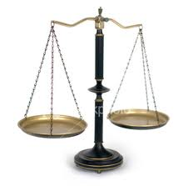
Priority 2. Pupil Assessment
Individualized
Feasible
Usually not test-based

Slide 16
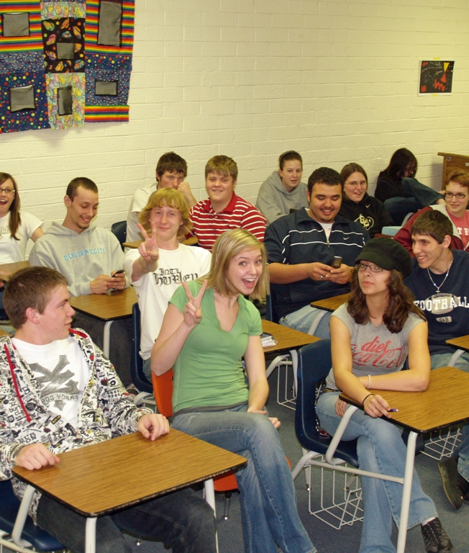
Priority 3. Classroom Organization and Community
Complexity
Class community
Teacher-student rapport

Slide 17
Priority 4. Inclusive Education
All students included
Explicit discussion
Teacher modeling

Slide 18
Priority 5. Subject Content and Pedagogy
Subject learning in TE
Preparation for later subject learning
Broader goals pursued through subjects

Slide 19
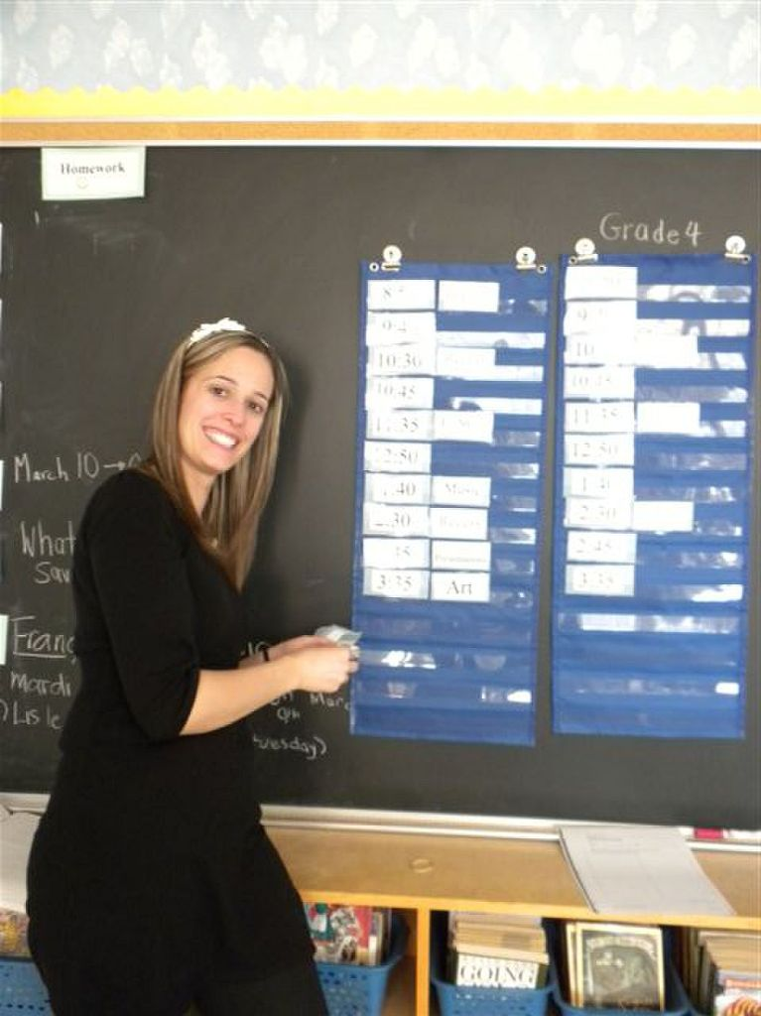
Priority 6. Professional Identity – Teachers as:
Ongoing learners
Emerging experts
Decision makers
Subject learners
Work-life balance

Slide 20
Priority 6. Professional Identity – Strong Stance
Decide what to emphasize and how to teach it
Some “teaching to the test” – but not a lot
Some direct teaching of “basics” – but keep it brief

Slide 21
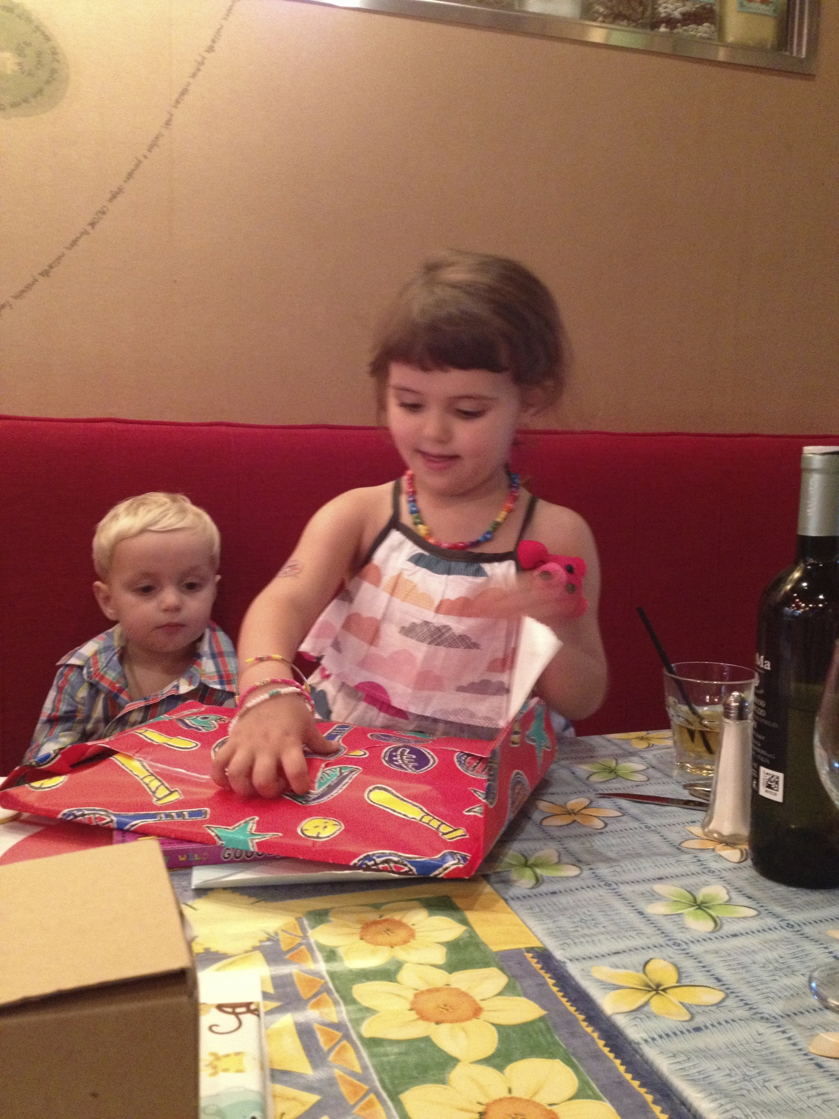
Priority 7. Vision for Teaching – Goals
Real-world understanding
Workplace preparation
Social development
Personal development
Love of learning

Slide 22
Pre-Service Educators Should Model This Approach to Teaching
Prioritize – don’t try to cover too much
Restrict detailed planning assignments
Integrate, individualize, be flexible
Dialogue with your STs
Get to know them
Social emphasis in the program

Slide 23
Practicum Experiences
STs should have extensive in-school experiences, preceded and followed by discussion in pre-service courses
Teacher educators should spend a lot of time in schools: (i) supporting STs, (ii) learning from teachers, and (iii) finding suitable mentor teachers

Slide 24
Teachers’ learning, expertise, and judgment should be acknowledged and celebrated. External input can be very valuable, but must be offered in a respectful, dialogical manner.

Slide 25
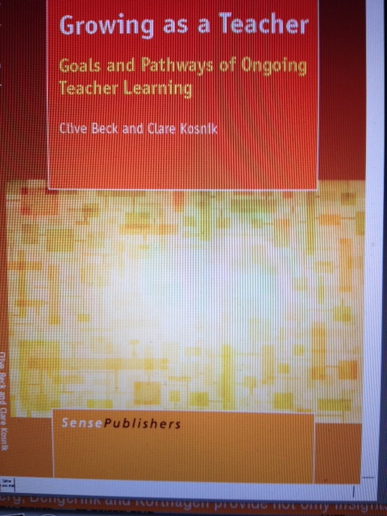

Slide 26
Stay connected with us:
www.literacyteaching.net

