Slide 1
TEACHER INQUIRY AS RESEARCH AND KNOWLEDGE GENERATION
Clive Beck & Clare Kosnik
OISE/University of Toronto

Slide 2
OUR LONGITUDINAL STUDY OF TEACHERS
42 teachers – mainly elementary and middle school
20 began teaching in 2004 and 22 in 2007
Interviewed and observed every year since then
Largely qualitative study

Slide 3
How extensive was the teachers’ learning in this initial period?
How much impact did it have on their growth as teachers?
In what sense (if any) can their inquiry be regarded as “research” and “knowledge generation”?
STUDY QUESTIONS

Slide 4
KEY THEORISTS
Donald Schon (1983)
Ken Zeichner (1995)
Wilfred Carr (1995)
Marilyn Cochran-Smith & Susan Lytle (1993, 2009)

Slide 5
FINDINGS

Slide 6
1. The Teachers Learned a Great Deal by Informal Means
classroom management
prioritization of goals and topics
flexible planning
integration and individualization of teaching
how to make teaching engaging and relevant
use of technology
more effective and feasible assessment
better work-life balance

Slide 7
Year 8 Teachers’ Average Ratings for Professional Development Activities (scale 1-5)
Trying things out in your own classroom 4.7
Observing/planning with/talking to other teachers in your school, at or near grade level 4.6
Observing/talking to teachers beyond your school 3.8
Formal mentoring by another teacher, coach or administrator 3.4
PD at a school-wide level 3.4
Short PD events beyond school 2.9
Your own professional reading 4.4
Your own subject content reading 4.3

Slide 8
2. The Teachers Also Learned by Formal Means, But to a Much Lesser Extent

Slide 9
3. The Teachers’ Informal Learning had a Major Impact on Their Ideas and Practices

Slide 10
4. Very Little of the Teachers’ Informal Learning Was Seen by Them as Research

Slide 11
CONCLUSIONS

Slide 12
1. Teachers’ Informal Learning Is Extensive and Important, at Least During Their First Eight Years

Slide 13
2. This Informal Learning Is “Inquiry,” “Research,” and “Knowledge Generation”

Slide 14
3. There Are Practical Concerns about Calling Informal Teacher Learning “Research”

Slide 15
4. Teachers Are in an Ideal Position to Conduct Inquiry

Slide 16
5. Academics Have Advantages But Also Disadvantages as Educational Researchers

Slide 17
6. Academics Should Accept Teachers’ Ability to Generate Knowledge and Work WITH Them:
Supporting their inquiry
Studying what they have learned
Making it available to academics, policy makers, administrators, and other teachers

Slide 18
7. Principals and System Administrators Should Create Many More Opportunities for Teachers to Learn from Each Other

Slide 19
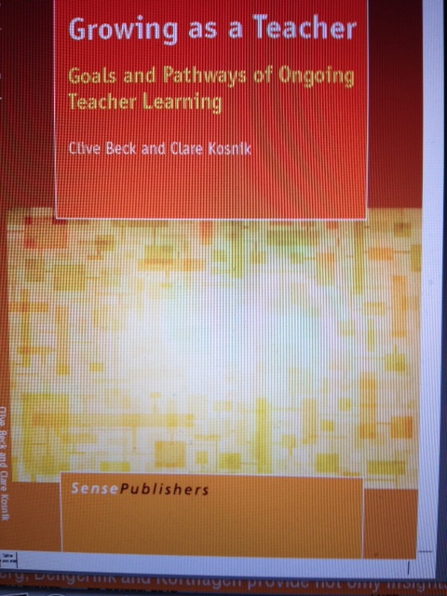

Slide 20
Stay connected with us:
www.literacyteaching.net

