Slide 1
Reconceptualizing Their Teaching Over Time: Goals and Pedagogies of
Mid- and Later-Career Literacy/English Teacher Educators
Clare Kosnik and Clive Beck
Ontario Institute for Studies in Education/
University of Toronto
September 2014

Slide 2

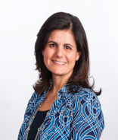

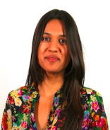
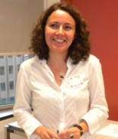
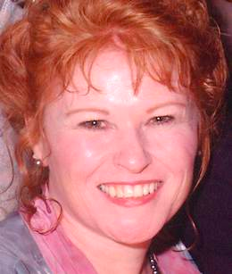

Slide 3
Specific Goal: how do LTE’s goals and pedagogies change over time?
Overall Goal:
to study in depth a group of literacy/English teacher educators, (LTEs) with special attention to their backgrounds, knowledge, research activities, identity, view of current government initiatives, pedagogy, and course goals.

Slide 4





Slide 5
Sub-set of Participants
Experience as a classroom teacher
0 years = 1
1-5 years = 1
6-10 years = 9
11-20 years= 6
21+ years = 4
Years at the university
6 -10 years = 10
11-15 years = 2
16 -20 years= 5
21+ years = 4

Slide 6
Challenges
Beginning Teacher Educators
one cannot simply replicate one’s practices as a classroom teacher in the university setting; there is no direct application of the skills used for teaching children to teaching adults.
Mid- and later-career
solving the problem of not having recent experience as a classroom teacher,
integrating digital technology
balancing administrative duties with their teaching

Slide 7
Pedagogy of Teacher Education
“If students of teaching are to genuinely ‘see into teaching,’ then they require access to the thoughts and actions that shape such practice; they need to be able to see and hear the pedagogical reasoning that underpins the teaching that they are experiencing” Loughran
Being sensitive;
building trust;
being honest;
valuing independence;
reflection;
risk-taking

Slide 8
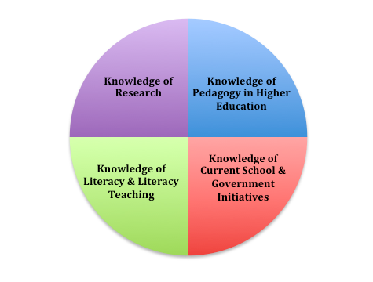

Slide 9
Being an LTE in the 21st century is ….
Julianna: “fun because we have a rich environment as long as you can maintain engagement in the richness and not get grounded down by the emphasis on phonics.”
Sara: “exciting … we are at the forefront”
Demerra: “fulfilling, engaging, and entangled.”

Slide 10
Developing Goals for Courses
Draw on:
Classroom teacher experiences
Research
Reflection on and reflection in action
Collaboration with colleagues

Slide 11
Bob: “learn to focus on the pupils … unpack their beliefs … develop an identity as a professional.”
Martha Ann: “develop a sense of self-efficacy … learn to take initiative ….”
Caterina: “students should see themselves as professionals not college students.”

Slide 12
Justin: “prepare student teachers for a lifetime of teaching; prepare them to be public intellectuals; see schools as an emancipatory space”
Emma: “understand current curriculum … develop skills to plan and asses … be independent thinkers who are not just teaching for the schools we have .”

Slide 13
Developing a Teaching Style
To what extent do you draw on your experiences as a classroom teacher?”
17 said a great deal
4 replied not at all

Slide 14
On a good day … one has some credibly with ones students precisely because one can talk from first hand experience. At the same time, on a bad day, I’m aware that students think that this must have happened in some era where dinosaurs roamed the earth and its really not relevant to current reality.

Slide 15
Justin: “to be a good listener … structured but there time for discussion and activity.”
Mary: “my teaching is driven by inquiry …few lectures and few readings … teaching for depth … address hot button topics … less concerned with providing practical tips.
Caterina: “student teachers moving around not simply being passive recipients of my knowledge.”

Slide 16
Jessie: “a flattened hierarchy … camaraderie … we are “in it together.”
Stella: “I've never been a teacher who wants to give people answers. …sometimes people find that infuriating .. I want to encourage them to think and experiment and take risks.”

Slide 17
* debates on hot topic issues;
* creating and/or analyzing a videos
* on-line discussion groups;
* book talks and literature circles;
* on-line streaming of Shakespearean plays;
* children’s literature;
* tutoring programs;
* assisting with inservice on drama for teachers;
* Slam Poetry;
* field trips and/or community walks;
* guest speakers (teachers/community leaders);
* photographs of places for literacy;
* digital technologies

Slide 18
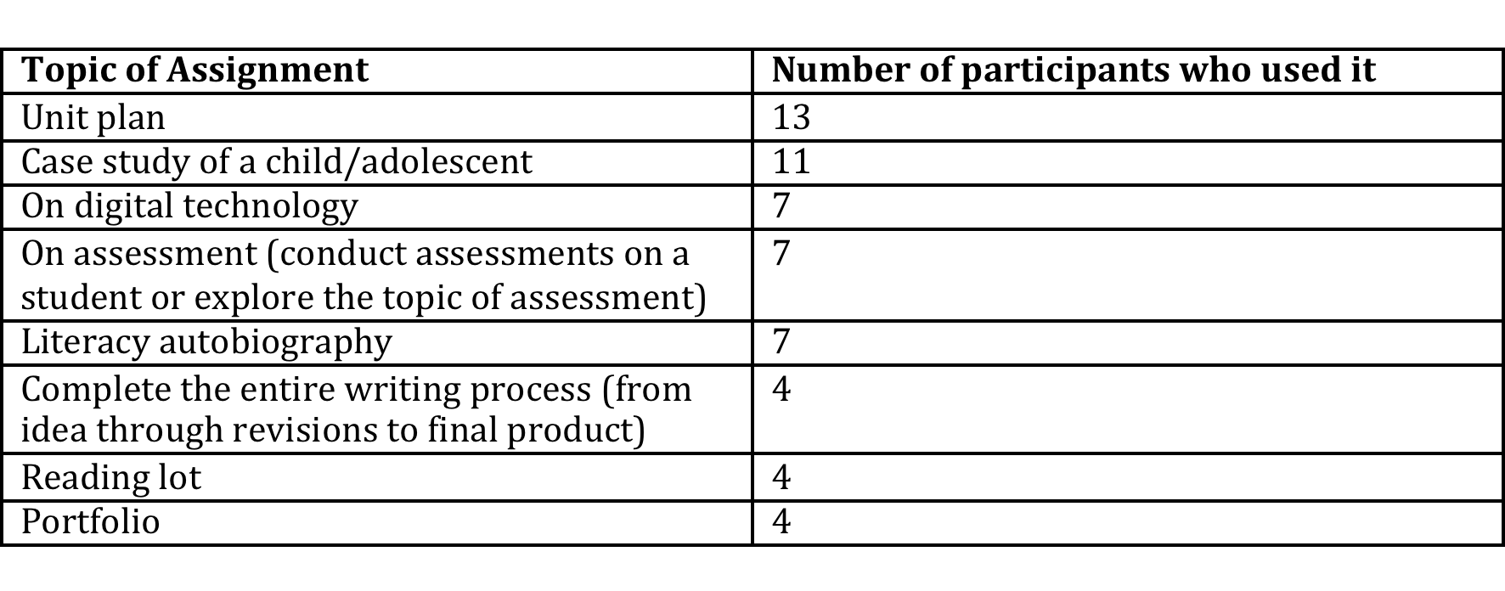

Slide 19
Being in a Constant State of Revision
Sara recalled that it “took six months to prepare the [new] unit guide so that when we started it was in the best position.”

Slide 20
Multiple forms of “data” to inform their teaching
thought about their work (reflection-on-action)
observed how student teachers participated in class discussions (reflection-in-action)
noted the gaps in student teachers’ knowledge in their written assignments
listened to the questions student teachers raised.

Slide 21
How I have changed
Chester: “learning takes time. I've become much more confident and I think that's changed my practice. Not panicking, not rushing, not getting anxious about things.”
Caterina: “as a beginning teacher educator I was really focused on theory” but she now balances theory with practice.

Slide 22
Emma: course construction has improved because there is an overall design for the course making it more coherent.
Carolina: no longer expects student teachers to want to know everything … has “mellowed” … not as intense ... more realistic what can be accomplished.”
Martha Ann: goes “more in depth” and builds time in class for application.

Slide 23
Working in Politicized Context
Carolina: feels pressure from “all government levels … for your teachers to be accredited … your university has to tick these boxes. We now have exit testing for our pre-service teachers … we’ve got three layers of hoops … and at the center of that is students. Sometimes we seem to forget that that's what we are here for.

Slide 24
I've become more aware of pressures on me to perform and to make sure that what I do is going to be compliant or not found wanting of any of kind of OFSTED regulation … If they came in and within two days they could say our course didn't fit the bill and that would be curtains [for the program]. And that's terrifying.

Slide 25
Implications: Developing a pedagogy of teacher education
Goals
Pedagogies
Research during and after the program on student teachers and teacher educators

Slide 26


Slide 27
Stay connected with us:
www.literacyteaching.net

