Slide 1
Teaching Student teachers How to Teach for Relevance, Integrating Curriculum around Big Ideas and Key Values
Clive Beck, Clare Kosnik, Shelley Murphy,
and Elizabeth Rosales
OISE/University of Toronto

Slide 2
Longitudinal Study
42 teachers, mainly in Ontario, of whom 20 began teaching in 2004 and 22 in 2007.
Observations and interviews every year
A key finding: Teachers increasingly teach for relevance

Slide 3
What is Teaching for Relevance?
(i) real world understanding
[T]here are so many specific curriculum expectations...but really science is about having big questions and figuring out how things work…[and] within a certain area, like weather, is it really important that the students know the names of clouds, or is it more important that they know about air masses and what causes rain to happen? Paul (year 8)

Slide 4
ii) way of life development
I want students to take responsibility for themselves and their learning, and get to know themselves: what kind of person am I, what kind of career should I have, what kind of people should I associate with? Paul (year 7)

Slide 5
Do Teachers Have Time to Teach for Relevance?
Yes! Teachers have students for 12 years, 10 months of the year. There is plenty of time to address fundamental aspects of reality and life. It’s irresponsible to just teach traditional content.

Slide 6
What about the Current Push toward Traditional Content Learning and Test Preparation?
We must DO BOTH: teach for content and relevance.
Content knowledge, e.g., about ancient empires, can help students understand the present day behaviour of politicians, bosses in the workplace, schoolyard bullies, and other people in their lives.
We just need to connect things more.

Slide 7
The main way to do both is to INTEGRATE teaching around big ideas and key values
Integration increases understanding, relevance, and interest; and it saves time.

Slide 8
How do They do It?
I like the idea of teaching around themes, categories that are broad so teachers can select what is applicable to the lives of their students…. A theme I’ve been emphasizing a lot over the past couple of years is pollution in our lakes and water systems and how ads are used to cover up that sort of thing. Kelly (cohort 2 – year 5)

Slide 9
How do They do It?
As part of a water unit in science, we looked at the news about the floods out West. And we asked things like: “Why is this happening? What’s the impact? To what extent are we responsible for it?” And while they were watching the news I asked them to make jot-notes in a specific role: as a farmer, a business owner, a parent, or a grandparent. And then they had to write a letter to somebody else: a grandparent writing to a farmer, or a business owner writing to the government. Carrie (year 7)

Slide 10
Integration Can Be Helped by Finding Suitable Teaching Materials
If the World Were a Village connects several subjects. The book shrinks the world population down to one hundred, so “the students can work with the figures more easily and see where the wealth disparities are.” The book touches on:
equity,
language,
math (data management, percent, fractions, ratio),
history (how did the people who have the resources get them in the first place),
science (life systems, including topics such as basic needs, access to clean water, and what happens to people who don’t have clean water). (paraphrase)

Slide 11
Integration and Relevance Require Strong Teacher Decision Making and Prioritization
[Y]ou have to judge what’s important and weed out what’s not. Marisa (year 7)
[W]hat I’ve come to realize is that whatever curriculum is given to you in the classroom, it’s up to you as a teacher to modify it and make it meaningful to your students. Of course you have to meet their IEP goals; but whatever their age, their grade, their classification you have to make it meaningful. Deirdre (cohort 2 – year 5)

Slide 12
A Firm Teacher Stance is Needed toward School System Curriculum and Testing
When you start off teaching…you feel there’s always a better way. And the ‘best practices’ [mandated by the system] work for many situations, but often they don't.... So I do some of what the system wants but I do other things based on observing my students, interacting with them, sitting in their little groups. Dina (cohort 2 – year 4)

Slide 13
Probably my biggest change over the years is realizing how many new [system] initiatives there are every year…. I’ve learned how to take whatever it is and transform it into something I know is going to work for my classroom. Serena (year 8)

Slide 14
Implications for Pre-service and In-service Teacher Education

Slide 15
Teaching for relevance requires solid initial preparation
Teachers need encouragement and support to make teaching EVEN MORE RELEVANT
While we were impressed we felt that in some areas (e.g., politics, class issues, technology, life goals) there could be even more exploration of real-world and way of life matters.

Slide 16
Teaching for relevance requires solid continuing PD
Initial teacher educators
PD providers
School principals
Teachers themselves

Slide 17
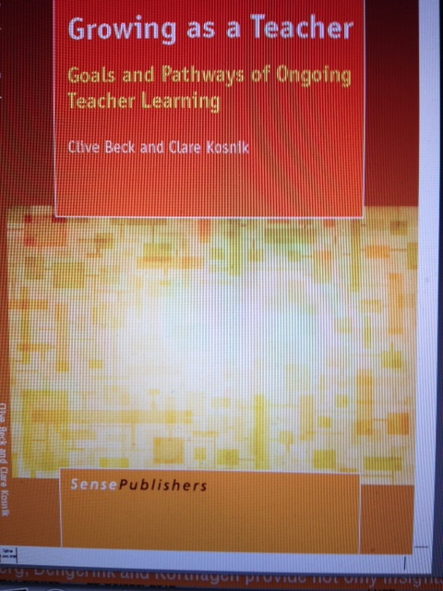

Slide 18
Stay Connected
Check out our website:
www.literacyteaching.net

