Slide 1

Literacy/English teacher education in Canada
Clare Kosnik

Slide 2
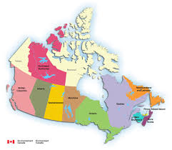

Slide 3
Anything goes in canada!
Undergraduate programs
Graduate programs
1 literacy course (36 hours) to a literacy specialization
No federal department of education – provincial jurisdiction
No common standards
Low level of compliance or oversight
Exit requirements (standardized test or portfolio) vary

Slide 4
International Study of Literacy/English teacher educators
Years as a Teacher
0 years = 1
1-5 years = 3
6-10 years = 12
11-20 years= 6
21+ years = 6
Years at the University
1-5 years = 7
6 -10 years = 10
11-15 years = 2
16 -20 years= 5
21+ years = 4

Slide 5
What have we found?
Variability in goals
Phonics …Critical Literacy …. Multiliteracies ….
Common practices (e.g., get to know your students, literacy autobiography)
External pressure
Communication practices are changing. What should we do in teacher education?

Slide 6
Consistency with other sections of your course/module
NA – 1
Level 1 – 7
Level 2 – 7
Level 3 – 3
Level 4 – 10
Level 5 – 0
Scale of 1 – 5 with 5 being the highest

Slide 7
LTEs teach who they are
Canadian Context
Sharon – writing process
Lance – drama and children’s literature
Amelia – aboriginal education and digital technology
Jessie – multiliteracies
Jane – storytelling
Margie – novel study

Slide 8
Consistency?
A Plus and a Minus

