Slide 1
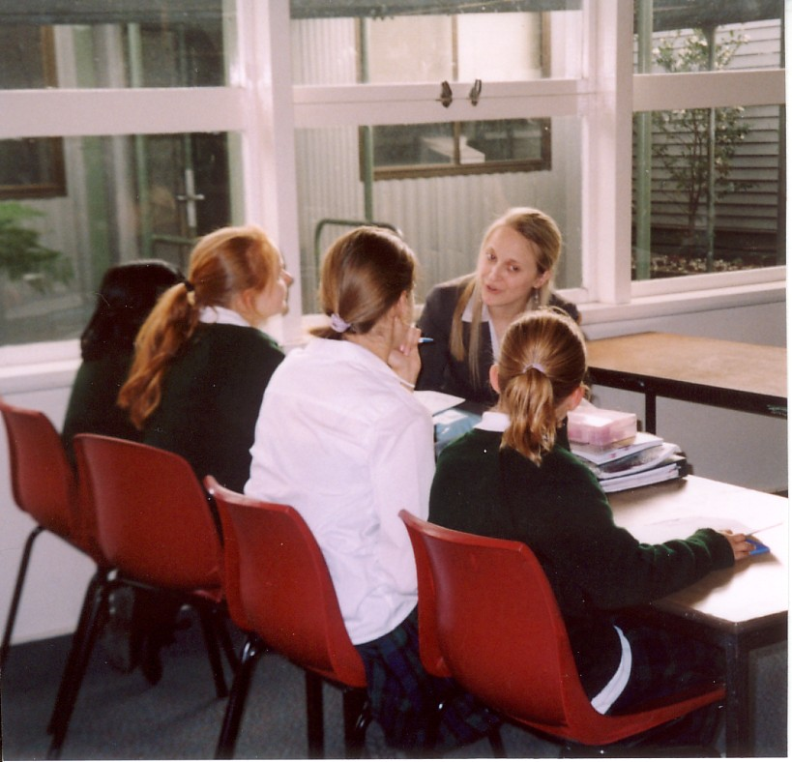
Complying with and
(occasionally) speaking back to standards-based reforms in teacher education in Australia
Graham Parr & Scott Bulfin
SSHRC Group - London
June 2014

Slide 2
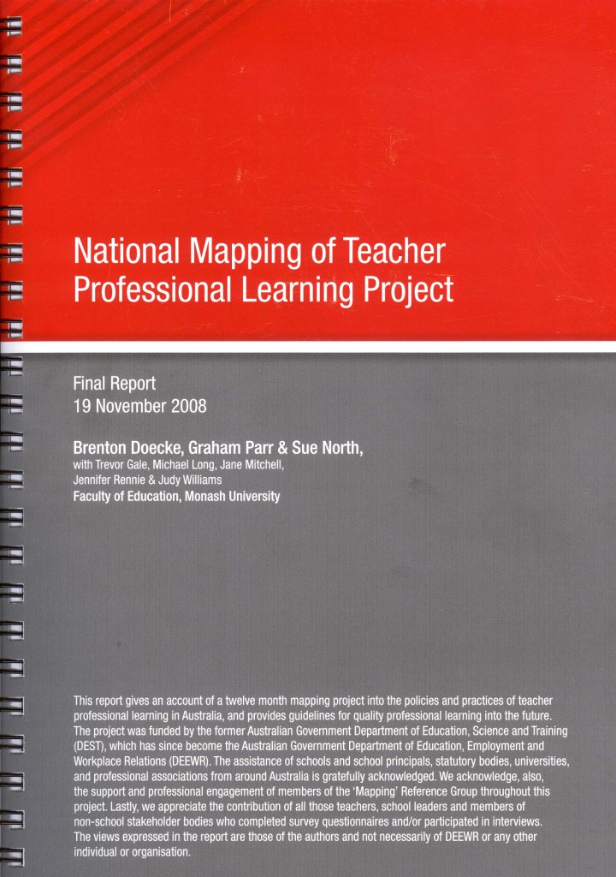
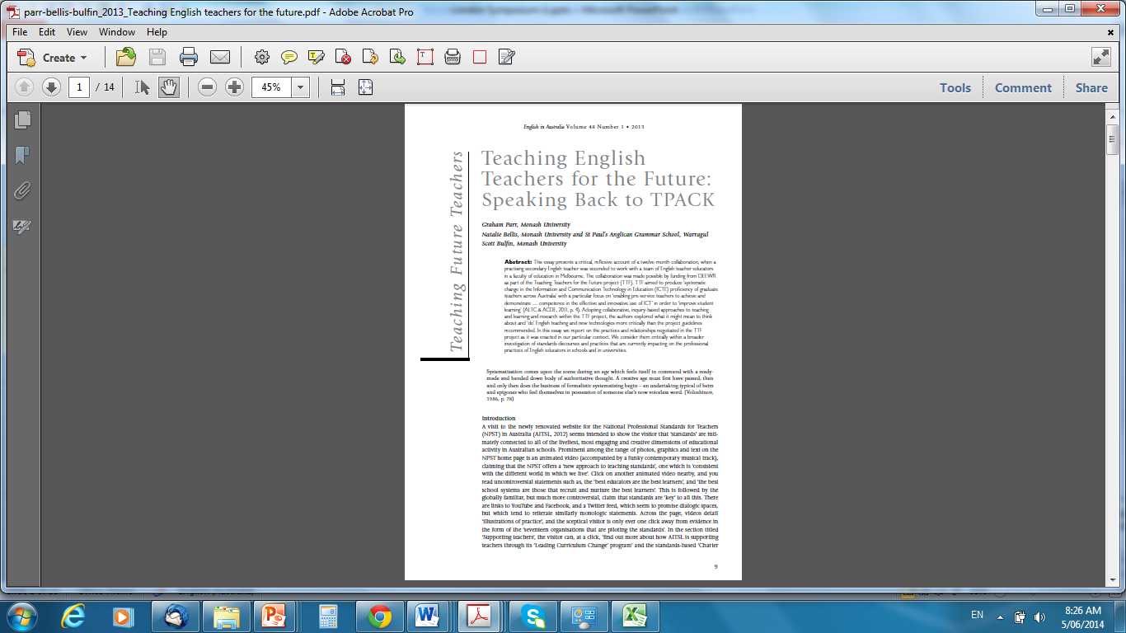
1. Report for DEEWR into Teacher Professional Learning in Australia
Doecke, B., Parr, G., & North, S. et al. (Nov., 2008).
National Mapping of Teacher Professional Learning in Australia. Report. Canberra: DEEWR.
http://apo.org.au/files/Resource/national_mapping_of_teacher_professional_learning_project.pdf
Teaching (English) teachers for the future: Speaking back to TPACK
Parr, G., Bellis, N., & Bulfin, S., (2013). Teaching English teachers for the future: Speaking back to TPACK. English in Australia, 48(1), 9-22.
AND
Creativity in English pre-service teacher education
Parr, G., Turvey, A., Lloyd, J., & Castaldi, R., (2014, in press) Creativity in pre-service and early-career English teaching: Negotiating a hostile policy environment. In B. Doecke, G. Parr & W. Sawyer (Eds.), Language and creativity in contemporary English classrooms. Putney, NSW: Phoenix Education.

Slide 3
Standards-based reforms into Australia
(2008-2013)
National tests of literacy and numeracy (NAPLAN) (2008) –
Grades 3, 5, 7 and 9: http://www.nap.edu.au/
MySchool website(2009): http://www.myschool.edu.au/
National professional teaching standards (2012): http://www.teacherstandards.aitsl.edu.au/
National curriculum (2011): http://www.australiancurriculum.edu.au/
National standards (and procedures) for accreditation of teacher education (2012): http://www.aitsl.edu.au/verve/_resources/Accreditation_of_initial_teacher_education_file.pdf
National standards for school principals (2013): http://www.aitsl.edu.au/school-leaders/australian-professional-standard-for-principals/australian-professional-standard-for-principals.html

Slide 4
Student learning standards discourses
  Tend to focus on: test scores, performance and development , student learning outcomes, progression points, comparisons, literacy and numeracy only…
  Tend to avoid: wellbeing, identity, growth, creativity, collaboration, autonomy, initiative, civic responsibility, the arts, physical education…
Teacher learning standards discourses
  Tend to focus on: tests scores, performance (vis-à-vis professional standards), student learning outcomes, career advancement, accountability, alignment, compliance… (innovation?)
  Tend to avoid: well being, professional identity, creativity, collaboration, risk taking, initiative, collegiality, ethics …

Slide 5
Standards-based reforms: responding to and pre-empting ‘risks’ posed by globalisation
  The more that societies become conscious of living in conditions of globalisation and experience the effects of borderless and interconnected world, the more these are considered a burden.
  Ulrich Beck (1992, 1994); Diane Ravitch (2003); Kostogriz (2011)
  Hence…
Desire for more control of national spaces
  nationalising curriculum – toward a single curriculum that is more easily testable and comparable
  mandated national testing regime
  uniform professional ‘standards’ – increasingly prescriptive
  more intrusive and more rigid (i.e., easily calculable) accountability regimes
  standardised notions of language: standard English as lingua franca and Standard Australian English

Slide 6
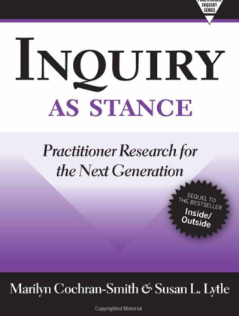
National Mapping of Teacher Professional Learning in Australia (Doecke, Parr, North et al., 2008)
.. and pre-service teacher education
Since 2000, standards-based reforms have been shaping
professional learning across Australia
  Supporting teachers to work in collaborative, focused
  teams/networks to build and renew their professional
  knowledge and practices not just an individual pursuit):
  e.g.,
    Australian Government Quality Teacher Program (2000 - ….)
    Victorian DEECD: Leading Professional Learning
    project (2007-2009)
  Development of collaborative statements of Declarations of
  Educational Goals (1989, 1999, 2008) (Hobart, Adelaide, Melbourne) – seemingly valuing cultural and linguistic diversity
  Encouraging sustained partnerships between schools and teacher education institutions as pre-service teachers
  transition into professional status and full time careers
  State-based bodies (VIT, NSWIT,…) providing frameworks
  or validating and recognising ongoing professional learning,
  and range of practitioner inquiry (such as action research) –
  see also Cochran-Smith & Lytle (2009)

Slide 7
What does ‘speaking back to standards-based reforms’ entail? Why bother?
Engaging dialogically with standards and standardisation – seeing value where there may be value, raising questions where there is cause for concern. (Even professional standards documents validate that.)
Working outside standards discourses is not an option. What is teaching or educational work that does not engage with the ethics and the politics of that work?
Engaging critically, creatively and ethically with students’ learning and with teachers’ teaching & learning is one way to advocate for the value and the potential of education in particular, national and global settings …

Slide 8
two examples

Slide 9
‘Teaching Teachers for the Future’ project
(ALTC, ACDE, DEEWR, 2011)
Aim: to produce “systematic change in the Information and Communication Technology in Education (ICTE) proficiency of graduate teachers across Australia”
by
“building the ICTE capacity of teacher educators and by developing materials to provide rich professional learning and digital exemplar packages”
Intended outcome: “pre-service teachers to achieve and demonstrate … competence in the effective and innovative use of ICT” which would (of course) “improve student learning”
Notes:
Graham

Slide 10
Teaching (English) teachers for the future: Speaking back to TPACK
Parr, G., Bellis, N., & Bulfin, S., (2013). Teaching English teachers for the future: Speaking back to TPACK. English in Australia, 48(1), 9-22.

Slide 11
English teacher professional learning: Learning to be creative and learning to become, creatively
Parr and Bulfin (2014 in press) English teacher professional learning: Learning to be creative and learning to become, creatively. In B. Doecke, G. Parr & W. Sawyer (Eds.), Language and creativity in contemporary English classrooms. Putney, NSW: Phoenix Education.

Slide 12
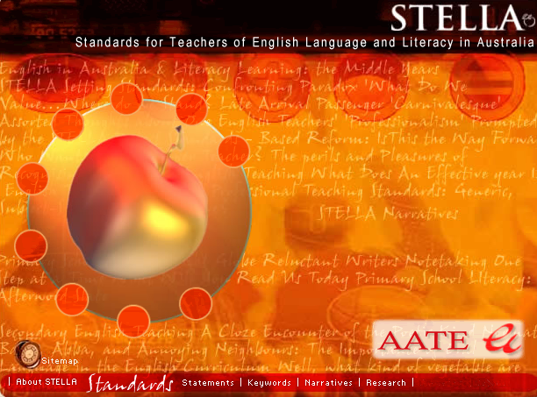
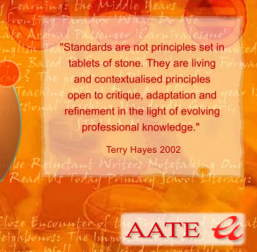
Professional standards generated by and for teachers (STELLA, 2001-2)

Slide 13

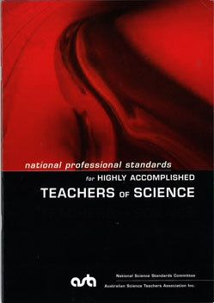


Slide 14
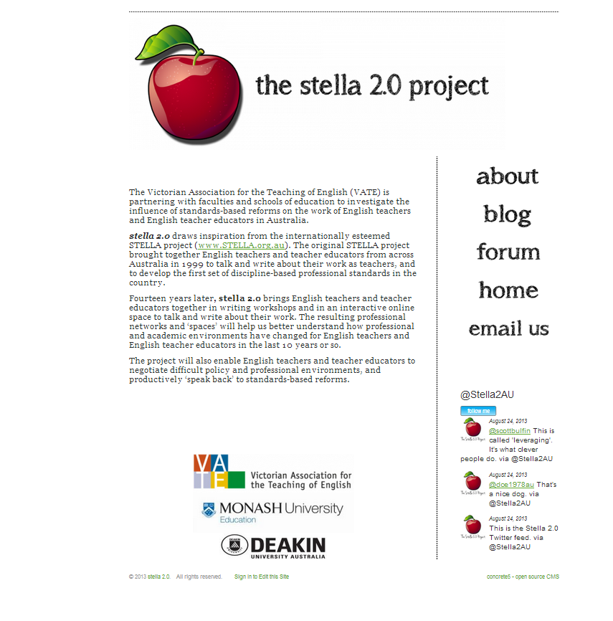
www.stella2.org

Slide 15
From Chanie (stella2.0 participant)
When I got a ‘proper’ teaching job with my own students, the first thing I wanted to do was test these theories out in the classroom. I was extremely fortunate to find myself in a faculty with a fellow former student of Scott and Graham, who has equal (if not greater) enthusiasm for trying novel and exciting stuff as well as asking that very important but rarely asked question…’what is the point of this task?’ We designed a creative response to The Curious Incident of the Dog in the Night-time by Mark Haddon – which included, amongst other options, the creation of an Instagram feed (10 images with comments) posted by the main protagonist and narrator.
Almost half of my class chose this option. Other than giving a pre-task work sheet to remind the students of the language conventions of Instagram and the expectation they go beyond the superficial level of merely storytelling, I left it open to their interpretation. They were buzzing like bees and the classroom was a crazy hub of activity. … To be honest, I had my doubts whether this task would lead to anything meaningful, both in process and outcome. The girls were passing phones around, feet on desks, some lying about on the floor. Fun was certainly happening in this mish mash of a space - something between a café, teenage bedroom and classroom - but was there any learning (or any work at all for that matter) going on?

Slide 16
Well, as they say, the proof in the pudding is in the eating, and I was overwhelmed by what these girls produced. Even students who had been struggling with English, found a ‘way in’ to engage with [the book’s main character] Christopher and they went even further, creating a new version of his story with the familiarity of social media, resembling what Yandell describes as text being “remade, in the readers’ interests” (2012: 54). What really amazed me is the girls had created new fictional users to represent the other main characters in the novel - the mother, father and teacher - and involved them in an interactive dialogue on Instagram. At no stage did I make this suggestion …

Slide 17
References
AITSL (2011). National professional standards for teachers. Canberra: Government of Australia.
Beck, U. (1992). Risk society: Towards a new modernity. New Delhi: Sage.
Beck, U., Giddens, A. & Lash, S. (1994). Reflexive modernisation: Politics, tradition and aesthetics in the modern social order. Stanford, CA: Stanford University Press.
Bellis, N. (2011, in press). ‘The visitor, the learner, the guest’: An Australian teaching in England. In B. Doecke, G. Parr & W. Sawyer (Eds.), Creating an Australian curriculum for English: National agendas, local contexts (pp. 67-81). Putney, NSW: Phoenix Education.
Berlin, D. (2011). Rational responses to high stakes testing: The case of curriculum narrowing and the harm that follows. Cambridge Journal of Education, 41(3), 287-302.
Bologna Policy Forum (2009). Statement by the Bologna Policy Forum. Louvain-la-Neuve, April, 2009.
Cochran-Smith, M. & Lylte, S. (2009). Inquiry as stance: Practitioner Research for the Next Generation. New York: Teachers College Press.
Darling-Hammond, L. (2004). Standards, accountability, and school reform. Teachers’ College Record, 106(6), 1047–85.
Hattie, J. (2009). Visible learning: A synthesis of over 800 meta-analyses relating to achievement. London & New York: Routledge
Kostogriz, A. (2011, in press). The future of diversity and difference: can the national curriculum for English be hospitable. In B. Doecke, G. Parr & W. Sawyer (Eds.), Creating an Australian curriculum for English: national agendas, local contexts (pp. 201 – 214). Putney, NSW: Phoenix Education.
National Commission on Excellence in Education (NCEE) (1983). A nation at risk: The imperative for educational reform (Report No. 065-000-00177-2.), Washington, DC: Government Printing.
OECD (2006). Higher education: Quality, equity and efficiency. Summary by the Chair of the Meeting of OECD Higher Education Ministers. Athens, June, 2006.
Parr, G. (2010). Inquiry-based professional learning: Speaking back to standards-based reforms. Teneriffe: Post-Pressed.
Ravitch, D. (2010). The death and life of the great American school system: How testing and choice are undermining education. New York: Basic Books.
Sachs, J. ( (2005, August). Professional standards: Quality teachers for the future. Keynote address at conference organised by the National Institute of Quality Teaching and School Leadership (NIQTSL). Sharing experience: Ways forward on advanced standards. Melbourne, Australia.
van der Wende, M. (2008). Rankings and classifications in higher education: A European perspective. In J. Smart (Ed.) Higher education: handbook of theory and research (pp. 49-72). New York: Springer.

