Slide 1
Literacy Teacher Educators: Practices, Experience and
Identities in Times of Educational Change
Clare Kosnik ckosnik@oise.utoronto.ca
2014

Slide 2






Slide 3
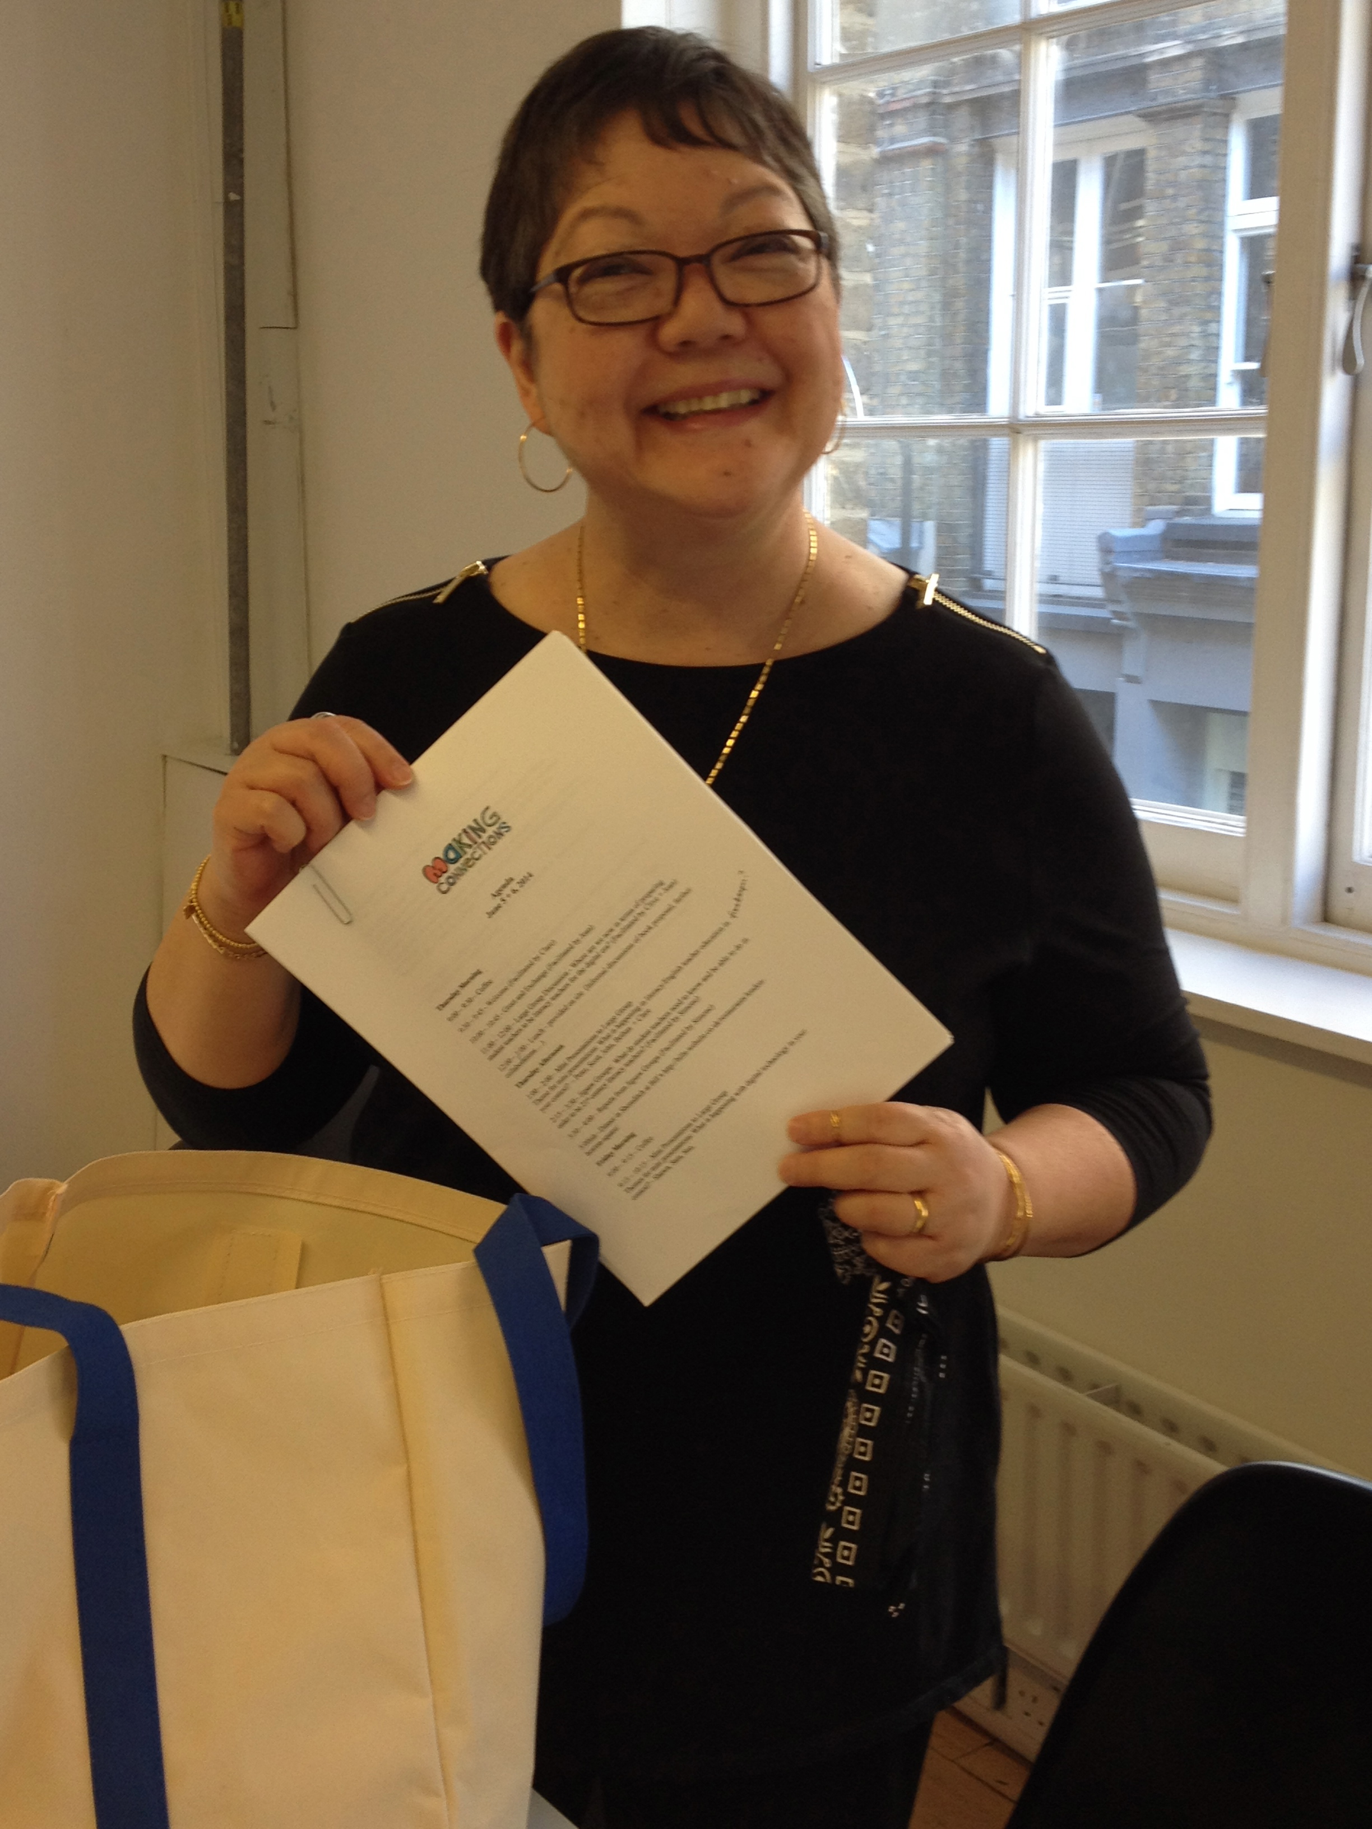
“Simply put, it is reasonable to assume that quality teacher preparation depends on quality teacher educators.” Goodwin and Kosnik

Slide 4
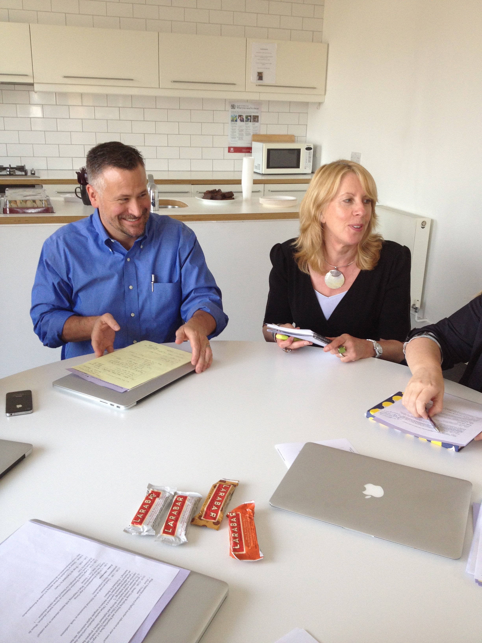
“few studies have looked at the professional experiences and induction needs of new teacher educators … new teacher educators are in general an under-researched and poorly understood occupational group” (Murray 2005, 68).

Slide 5
Two Key Findings
New teacher educators were novice teacher educators and researchers but were expected to be expert
New teacher educators felt like a fraud in higher ed – very stressed about new responsibilities and transition from classroom teacher to higher ed instructor was not seamless

Slide 6
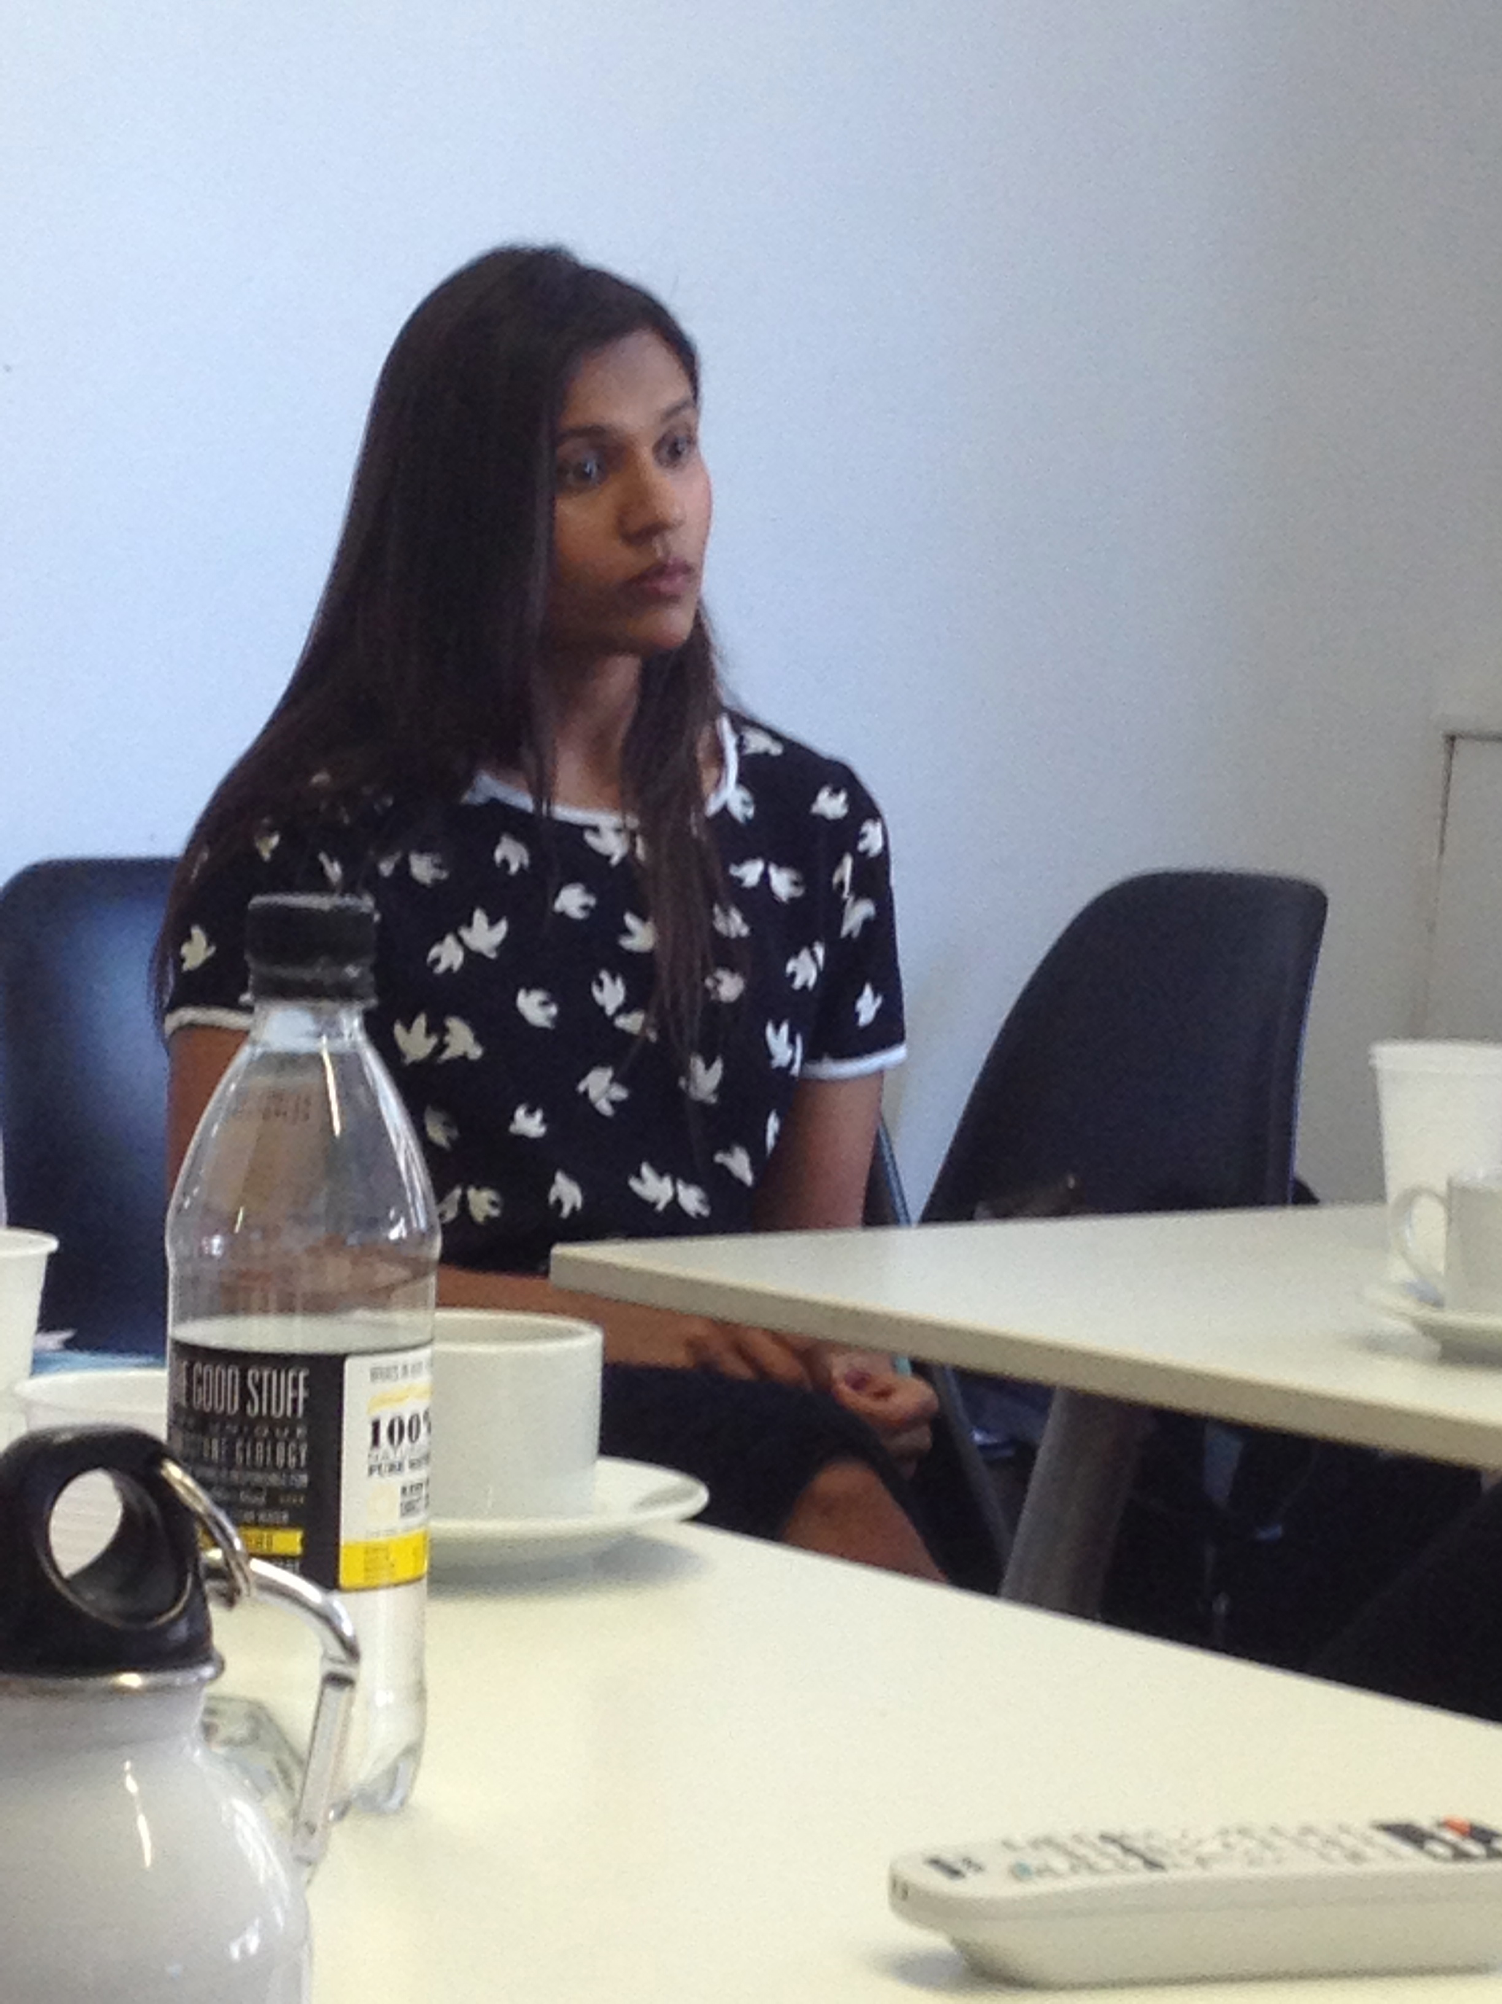
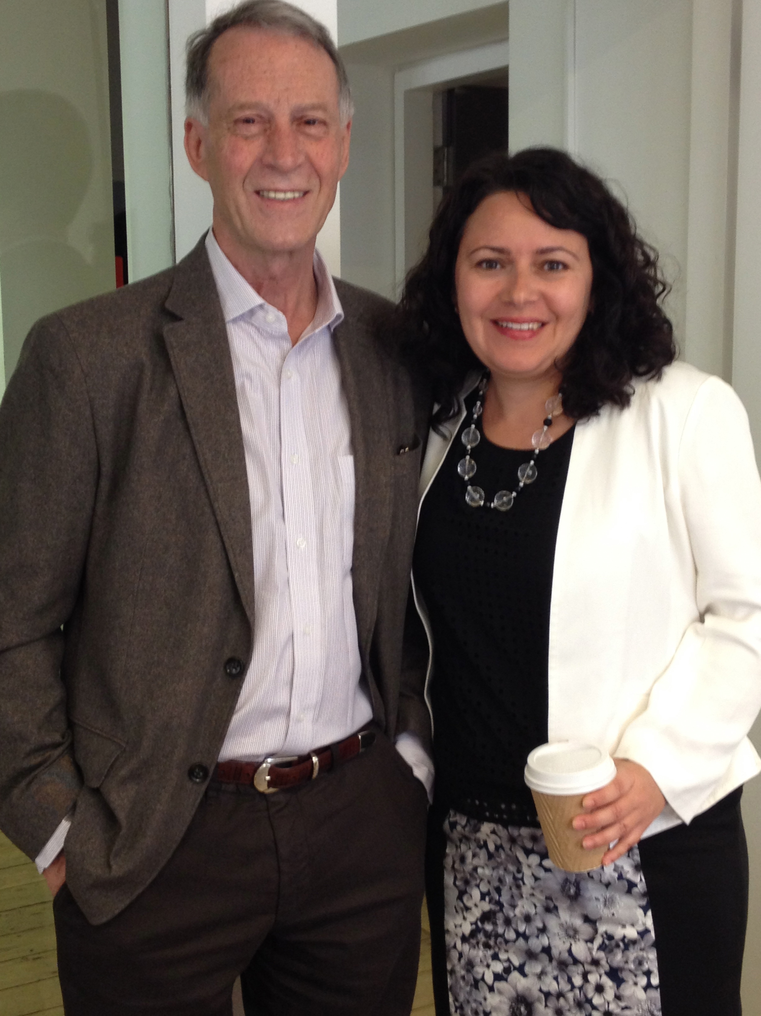
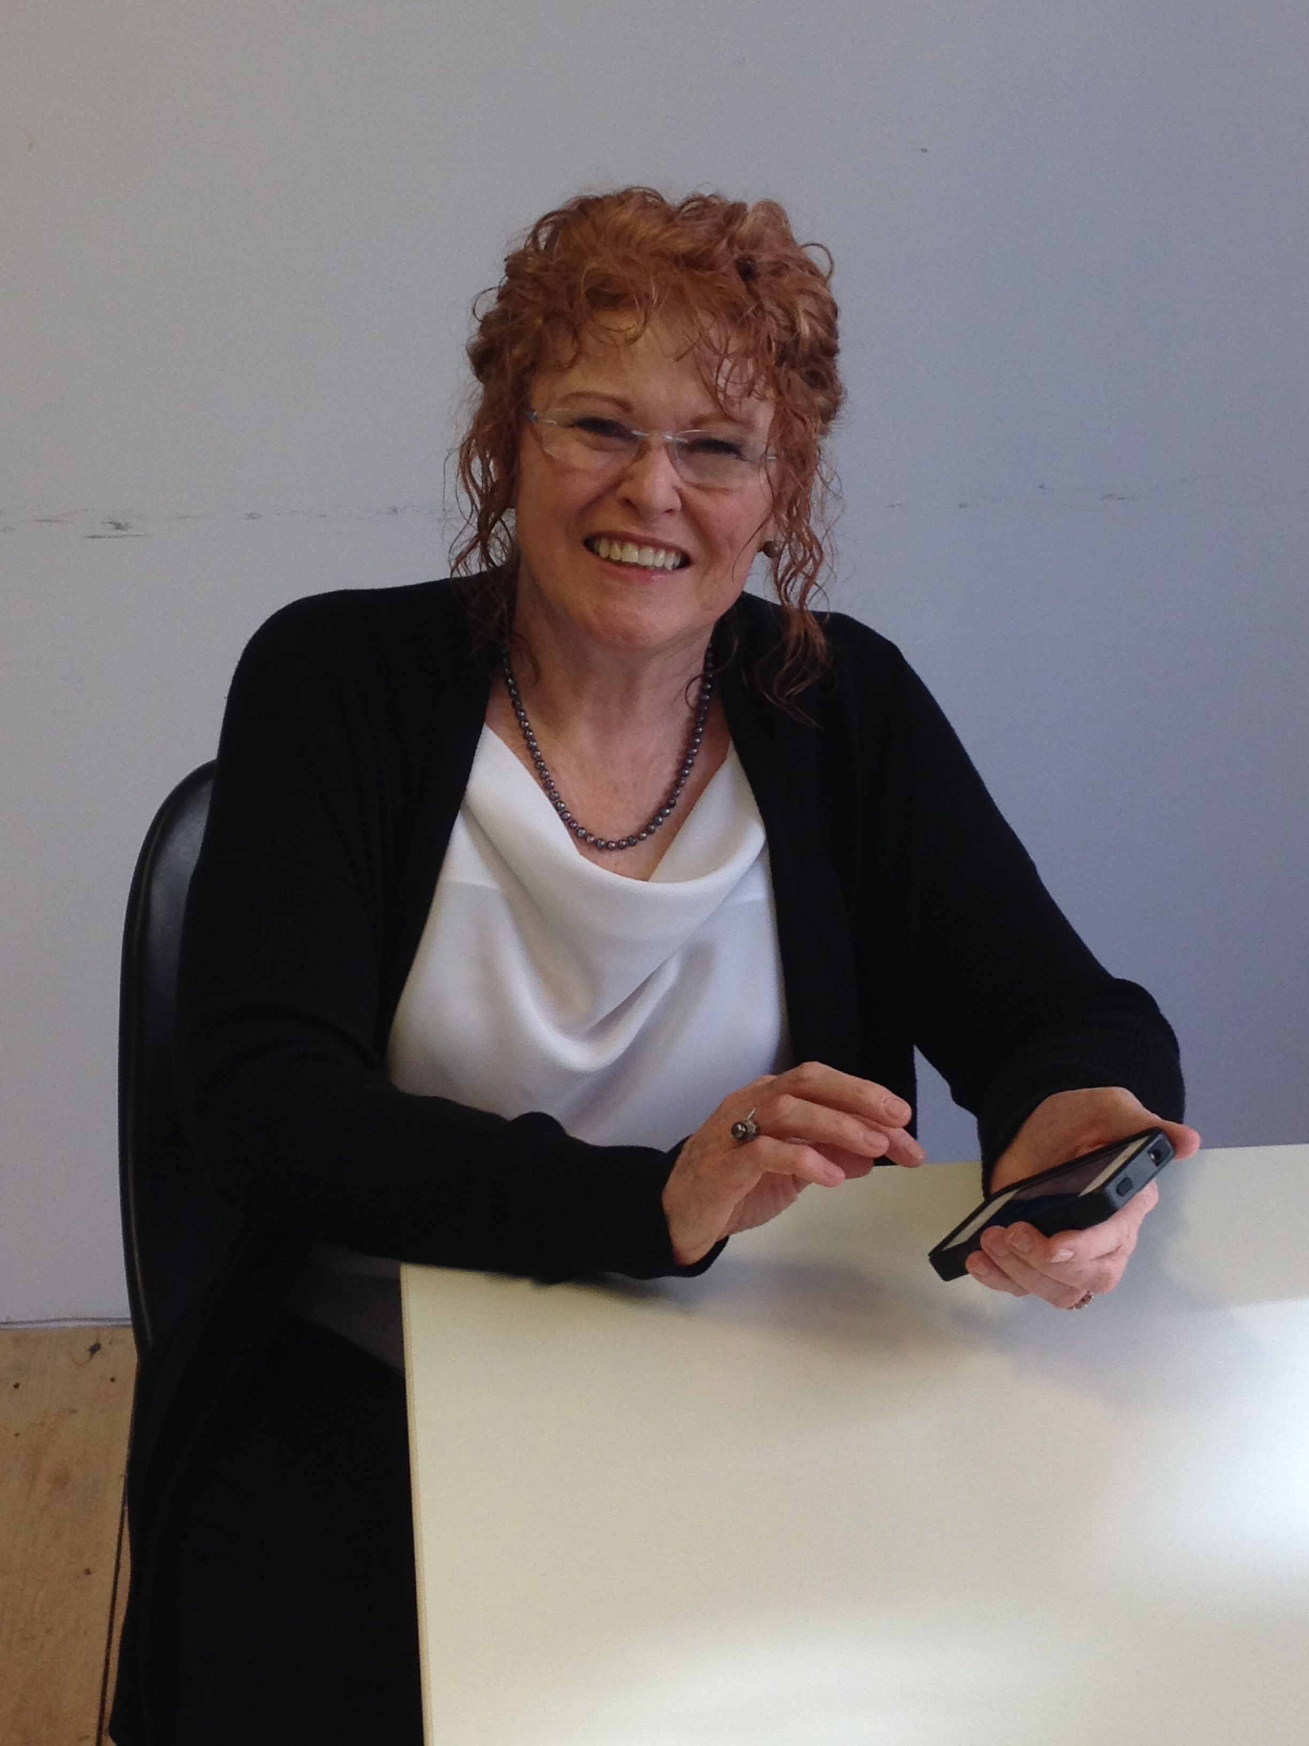
Overall Goal
to study in depth a group of literacy/English teacher educators, with attention to their backgrounds, knowledge, research activities, identity, view of current government initiatives, pedagogy, and course goals
.

Slide 7





Slide 8
Methodology
3 interviews:
Background
Pedagogy
Digital technology
Additional Documentation
Course outlines
Faculty profile
Academic writing
NVivo for data analysis
Nodes
Queries
Notes/memos

Slide 9
Participants
Experience as a classroom teacher
0 years = 1
1-5 years = 3
6-10 years = 12
11-20 years= 6
21+ years = 6
Rank at the University
Assistant Professor (Lecturer) = 6
Associate Professor =5
Senior Lecturer = 7
Full Professor = 5
Other =1
Contract = 4

Slide 10
Being an LTE is ….
Julianna: “fun because we have a rich environment as long as you can maintain engagement in the richness and not get grounded down by the emphasis on phonics.”
Caterina: “fun, exciting, but scary because things are changing so much.”
Demerra: “fulfilling, engaging, and entangled.”

Slide 11
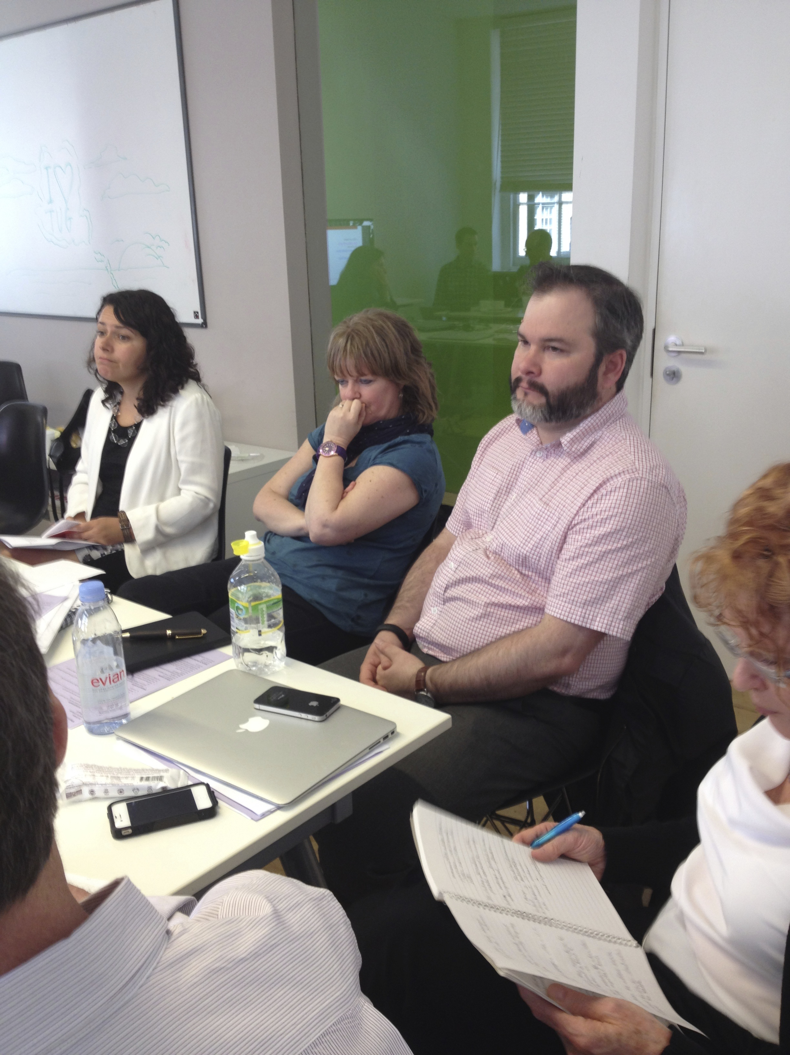
Qualities of an Effective LTE
caring
listener
reflective
team player
compassionate
flexible

Slide 12

Underappreciated!
Student teachers are more interested that I was a classroom teacher than that I have a PhD. Sara
Colleagues feel that research done in schools is inferior.

Slide 13
Influence on LTEs
A caring elementary/secondary school teacher
Experience as a classroom teacher
Life experiences (e.g., being ELL; being a parent)
Being part of an international research group
Mentor

Slide 14
What do LTEs need to Know?
Spheres of knowledge

Slide 15
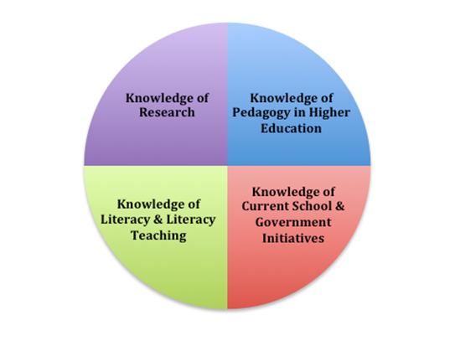

Slide 16
Knowledge of Research
Know how to read research
Use research findings in the development of courses
Conduct research – essential to being full member of higher education

Slide 17
Beforehand, I didn’t think it was important to do research because I thought your knowledge came from what you did [as a classroom teacher]. And I must say that now I can see what research brings to the process. You look at things differently in some ways ... you can see how what you’re seeing in one school is generalizable to schools across the board ... Beatrice

Slide 18
PhD instantly provides status:
“If everyone else has a doctorate, you have to have one too.” Beatrice
[O]f course I’m always finding out new things, but that's part of what I mean about being intellectually active and critical. Justin

Slide 19

Knowledge of Pedagogy of Higher Education
“If students of teaching are to genuinely ‘see into teaching,’ then they require access to the thoughts and actions that shape such practice; they need to be able to see and hear the pedagogical reasoning that underpins the teaching that they are experiencing” Loughran

Slide 20
On a good day … one has some credibility with one’s student teachers precisely because one can talk from first-hand experience. At the same time, on a bad day, I’m aware that students think this must have happened in some era where dinosaurs roamed the earth and it’s really not relevant to current reality. Justin

Slide 21
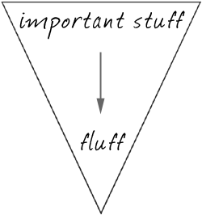
Developing Goals for Courses
Draw on:
Classroom teacher experiences
Research
Reflection on and reflection in action
Collaboration with colleagues

Slide 22
Goals for Courses
Justin: “prepare student teachers for a lifetime of teaching; prepare them to be public intellectuals; see schools as an emancipatory space
Caterina: “student should see themselves as professionals not college students.”
Emma: “understand current curriculum … develop skills to plan and asses … be independent thinkers who are not just teaching for the schools we have .”

Slide 23
Bob: “student teachers learn to focus on the students … to unpack their beliefs [about schooling] … and to develop an identity as a professional.”
Martha Ann: “develop a sense of self-efficacy … learn to take initiative … …. know children's literature … empower students.”
Jessie: “operationalize the theory” of literacy in her course.

Slide 24
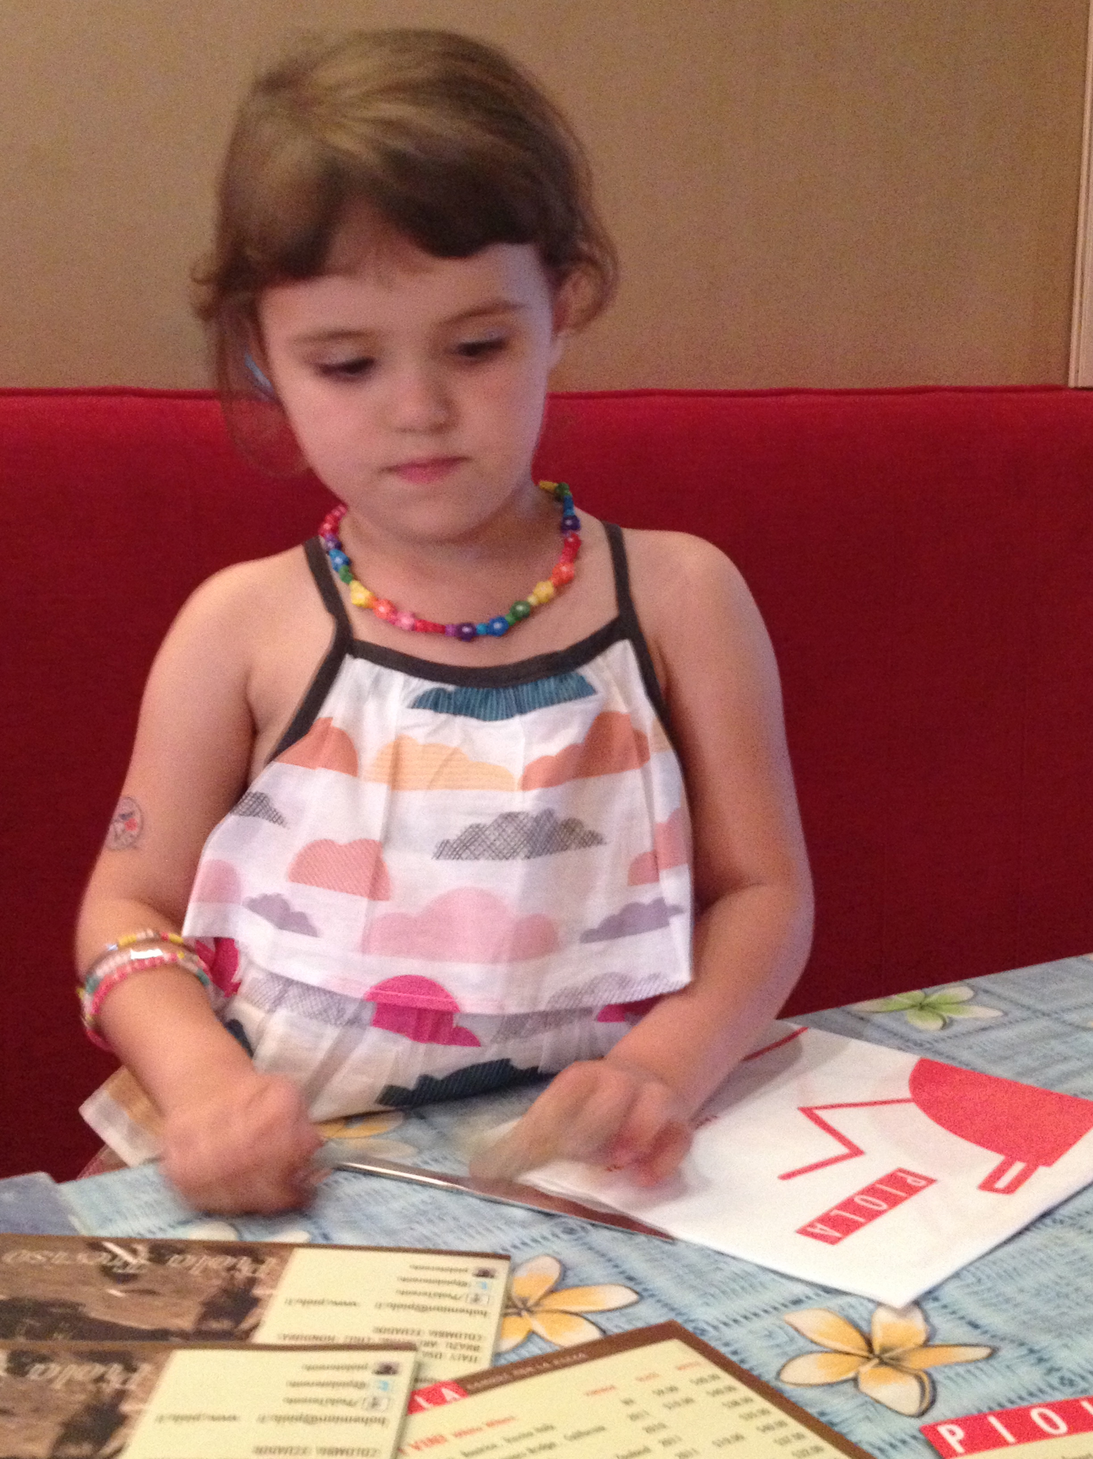
Drawing on Classroom
Teacher experiences
More than
telling stories
Continuity of Priorities
underserved communities
subject organizations
marginalized youth
teacher activism
teacher inquiry groups

Slide 25
* debates on hot topic issues;
* creating and/or analyzing a videos
* on-line discussion groups;
* book talks and literature circles;
* on-line streaming of Shakespearean plays;
* children’s literature;
* tutoring programs;
* assisting with inservice on drama for teachers;
* Slam Poetry;
* field trips and/or community walks;
* guest speakers (teachers/community leaders);
* photographs of places for literacy;
* digital technologies

Slide 26
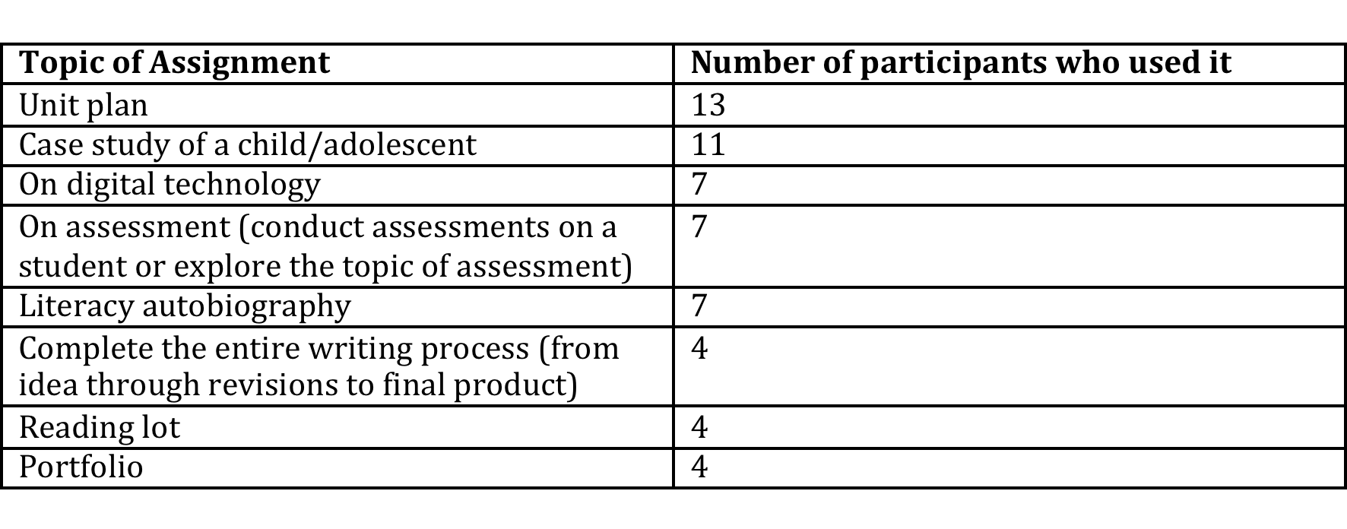

Slide 27
Improving their Teaching
Trial and error.
Student feedback and observation of student growth.
Collaboration with other teacher educators.
“Learning takes time. I've become much more confident and I think that's changed my practice. Not panicking, not rushing, not getting anxious about things.” Chester

Slide 28
Knowledge of Literacy and
Literacy Teaching
Our understanding of “literacy” is undergoing dramatic changes as an array of communication channels has extended the boundaries of communication and forms of knowledge construction
(Kress, 2010)

Slide 29









Slide 30
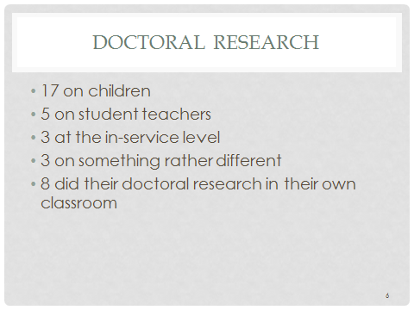

Slide 31
Knowledge of Current School and Government Initiatives
I have experienced 4 or possibly 5 different versions of the National Curriculum in the UK, so preparing them for the version that currently exists isn’t doing them any favors. They need to be prepared not only for this version but also for the other ones that will come along. Justin

Slide 32
Remaining Current # 1 Challenge
“blocked all access to [government] resources unless you are an employee of the education department.” Emma

Slide 33
remaining current
Drawing on personal networks (friends, and family)
Capitalizing on school-based activities.
I've become more aware of pressures on me to perform and to make sure that what I do is going to be compliant or not found wanting of any of kind of OFSTED regulation … If they came in and within two days they could say our course didn't fit the bill and that would be curtains [for the program]. And that's terrifying. StellaI

Slide 34
Identity

Slide 35
Identifying as a Teacher
“Student teachers want to see me as a teacher.” Carolina
“As soon as I start telling a story about my experiences as a classroom teacher they perk up.” Caterina
“But I do not want to be a glorified teacher who has been transplanted to higher education.” Rachel

Slide 36
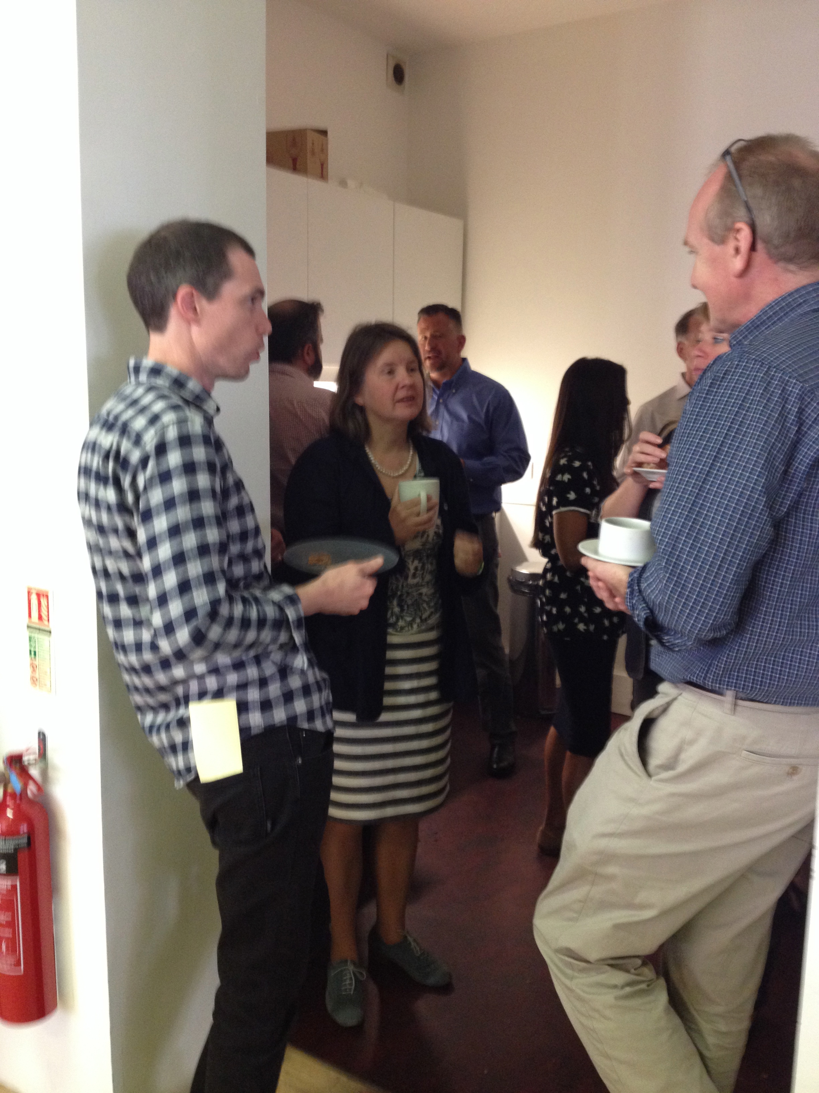
Must be able to walk the talk
Cannot shed your teacher Identity

Slide 37
Terms used to describe self
(could select more than one)
Literacy/English professor – 15
Teacher Educator – 17
Teacher – 14
Professor – 3
Other - Learn with kids – 1; Lecturer – 2; Teacher trainer – 1; Associate Dean – 1; Researcher -1

Slide 38
Academic communities
Own university – 15
Teacher research group or network -4
Classroom teachers – 8
Literacy association – 22
AERA -- 6
Other - 12 e.g., BERA, minority faculty group
Cannot find a home – 2

Slide 39
Feeling Like a fraud again!
If I go to Literacy conferences or English Teachers’ conferences, I know lots of people there and I’ve known them for a long time. I’m still the nice guy who’s got some good ideas of things to do with children’s books … but I don’t think I want to do more of that sort of thing. Chester

Slide 40
Implications
Feel underappreciated by colleagues + students
Value affective qualities of LTE
Tremendous pressure on LTEs
Community is beyond the university

Slide 41

Blurring boundaries
Must hold multiple identities
Audience for their work is both teachers and researchers

Slide 42
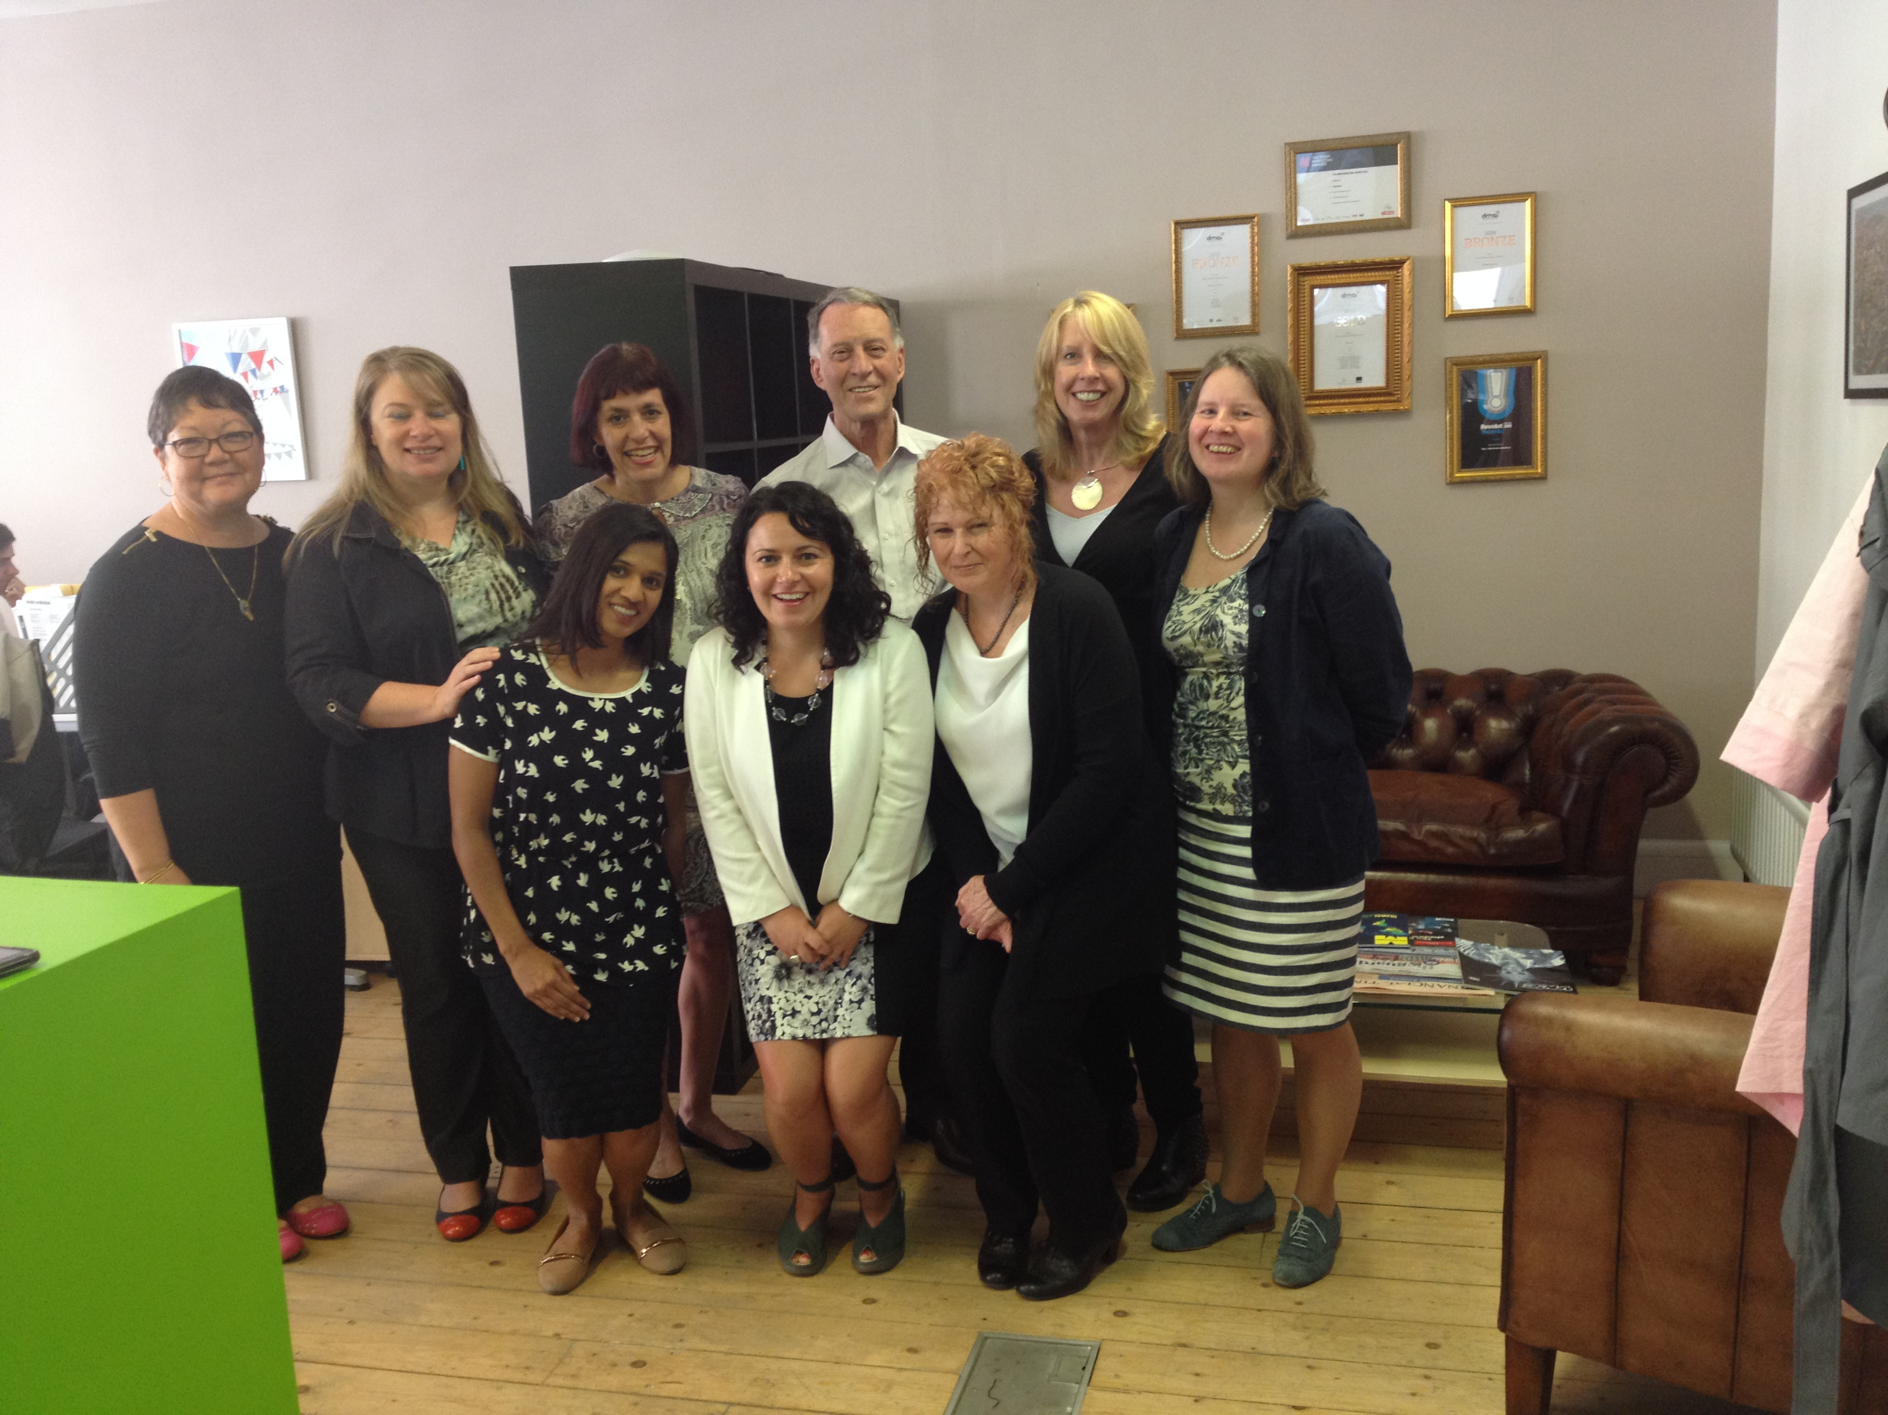
Building Bridges: Rethinking Literacy Teacher Education in a Digital Era

Slide 43
Stay connected with us: www.literacyteaching.net

